Slide 2
9:00-9:30
9:30-9:40 break
9:40-10:10
10:10-10:20 break
10:20-10:50
10:50-11:00 break
11:00-11:30
11:30-11:40 break
11:40-12:10
12:10-12:20 break
12:20-1:00

Slide 3
LEARN To
RECOGNIZE
A GOOD
KNOWLEDGE
TRANCE
Notes:
explain who frank is

Slide 4
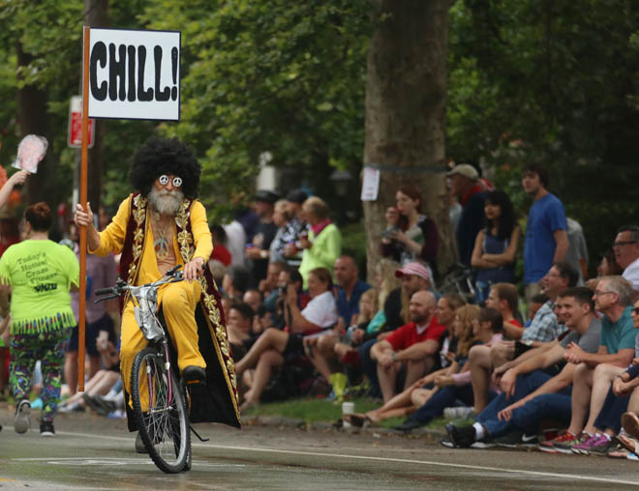
Notes:
Zigzagging through the Straight and Narrow (2009)

Slide 5
BREAK FROM THE BLUB
FIGHT IRONY
PERSEVERE
Notes:
Break from the blub: recognize the value of different approaches; avoid the generalist’s trap
Fight irony: e.g. brainfuck sucks
Persevere: google is useless, docs are very terse; stackoverflow: 1.4 mil javascript tags, 32k haskell, 8k prolog, 243 j

Slide 6


Slide 7
Motivation

Slide 8
Named-value model
Java, C, C++, C#, Javascript, Python, Ruby, PHP, Rust, Assembly, …
Necessitates sequencing of value updates!!
Programming with time…
Biductive computing
Prolog
Iterative distillation
Forth
Notes:
Clojure: datastructure transformations

Slide 9
Type threading
Haskell
Code generation
Lisp
Datastructure transformations
Clojure
Array computing
APL, J, K, Q, Numpy
Notes:
Clojure: datastructure transformations

Slide 10
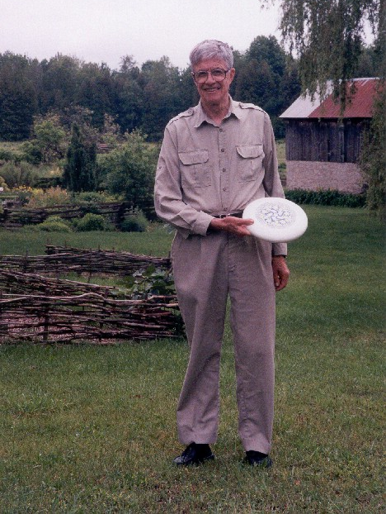
Notes:
“Ken at Kiln Farm with a prototype J Ultimate sportdisc (photo by Jana Michaud)”
http://webbox.lafayette.edu/~reiterc/j/ke_iverson/index.html

Slide 11
Incunabulum
typedef char C;typedef long I;
typedef struct a{I t,r,d[3],p[2];}*A;
#define P printf
#define R return
#define V1(f) A f(w)A w;
#define V2(f) A f(a,w)A a,w;
#define DO(n,x) {I i=0,_n=(n);for(;i<_n;++i){x;}}
I *ma(n){R(I*)malloc(n*4);}mv(d,s,n)I *d,*s;{DO(n,d[i]=s[i]);}
tr(r,d)I *d;{I z=1;DO(r,z=z*d[i]);R z;}
A ga(t,r,d)I *d;{A z=(A)ma(5+tr(r,d));z->t=t,z->r=r,mv(z->d,d,r);
R z;}
V1(iota){I n=*w->p;A z=ga(0,1,&n);DO(n,z->p[i]=i);R z;}
V2(plus){I r=w->r,*d=w->d,n=tr(r,d);A z=ga(0,r,d);
DO(n,z->p[i]=a->p[i]+w->p[i]);R z;}
V2(from){I r=w->r-1,*d=w->d+1,n=tr(r,d);
A z=ga(w->t,r,d);mv(z->p,w->p+(n**a->p),n);R z;}
V1(box){A z=ga(1,0,0);*z->p=(I)w;R z;}
V2(cat){I an=tr(a->r,a->d),wn=tr(w->r,w->d),n=an+wn;
A z=ga(w->t,1,&n);mv(z->p,a->p,an);mv(z->p+an,w->p,wn);R z;}
V2(find){}
V2(rsh){I r=a->r?*a->d:1,n=tr(r,a->p),wn=tr(w->r,w->d);
A z=ga(w->t,r,a->p);mv(z->p,w->p,wn=n>wn?wn:n);
if(n-=wn)mv(z->p+wn,z->p,n);R z;}
V1(sha){A z=ga(0,1,&w->r);mv(z->p,w->d,w->r);R z;}
V1(id){R w;}V1(size){A z=ga(0,0,0);*z->p=w->r?*w->d:1;R z;}
pi(i){P("%d ",i);}nl(){P("\n");}
pr(w)A w;{I r=w->r,*d=w->d,n=tr(r,d);DO(r,pi(d[i]));nl();
if(w->t)DO(n,P("< ");pr(w->p[i]))else DO(n,pi(w->p[i]));nl();}
C vt[]="+{~<#,";
A(*vd[])()={0,plus,from,find,0,rsh,cat},
(*vm[])()={0,id,size,iota,box,sha,0};
I st[26]; qp(a){R a>='a'&&a<='z';}qv(a){R a<'a';}
A ex(e)I *e;{I a=*e;
if(qp(a)){if(e[1]=='=')R st[a-'a']=ex(e+2);a= st[ a-'a'];}
R qv(a)?(*vm[a])(ex(e+1)):e[1]?(*vd[e[1]])(a,ex(e+2)):(A)a;}
noun(c){A z;if(c<'0'||c>'9')R 0;z=ga(0,0,0);*z->p=c-'0';R z;}
verb(c){I i=0;for(;vt[i];)if(vt[i++]==c)R i;R 0;}
I *wd(s)C *s;{I a,n=strlen(s),*e=ma(n+1);C c;
DO(n,e[i]=(a=noun(c=s[i]))?a:(a=verb(c))?a:c);e[n]=0;R e;}
main(){C s[99];while(gets(s))pr(ex(wd(s)));}
Notes:
One summer weekend in 1989, Arthur Whitney visited Ken Iverson at Kiln Farm and produced—on one page and in one afternoon—an interpreter fragment on the AT&T 3B1 computer. I studied this interpreter for about a week for its organization and programming style; and on Sunday, August 27, 1989, at about four o'clock in the afternoon, wrote the first line of code that became the implementation described in this document.
Arthur's one-page interpreter fragment is as follows.

Slide 12
Leaping head first into the stream of consciousness is good for your balance

Slide 13
Running a J program: No compiling. No linking.
No makefiles. No debugger required. You simply type J sentences and the interpreter executes them and displays any result.
J for C Programmers

Slide 14
Syntax

Slide 15
Statements are exactly one line long.
Numbers may be written 2, _2, 0.5, 5, 1e3, 2j5, 16b1f, 2p1, _, __
Adjacent numbers make a list: 3 5 2e3 7
Strings have single-quotes: 'hello'
Everything else is a built-in or user-defined word:
Verbs: +, -, etc.
Adverbs: ~, /, }, etc.
Conjunctions: ^:, ", @, &, etc.
Others: =., =:, NB., etc.
Notes:
2p1: 2*pi^1
2p5: 2*pi^5

Slide 16
You do not need to trouble yourself with the distinction between integers, floats, and complex numbers. If it’s a number, J will handle it properly.
J for C Programmers

Slide 17
Evaluation Rules

Slide 18
Forget the table of operator precedence!
J for C Programmers

Slide 19
RTL Evaluation:
2*4+5
18
2+4*5
22
(2*4)+5
13
Notes:
No precedence rules except parentheses ()

Slide 20

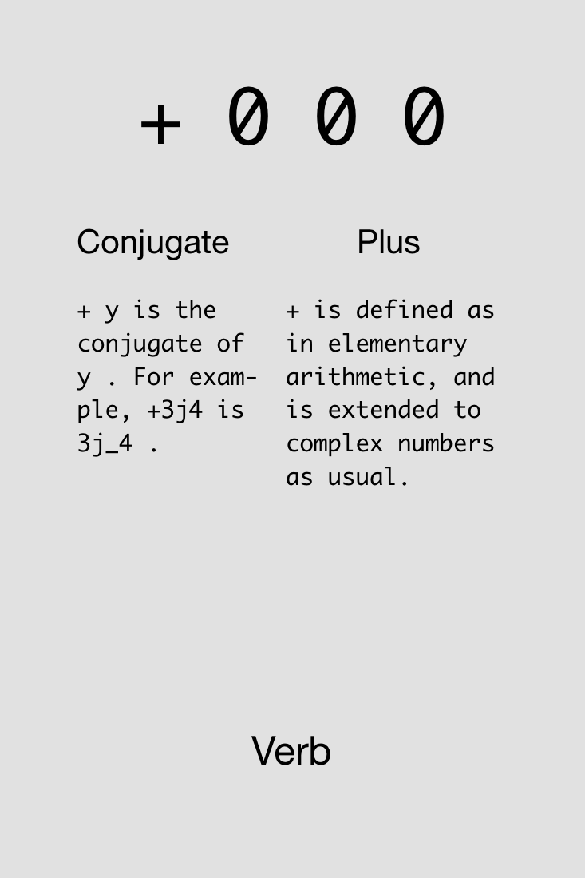
Notes:
Show example in J: 4+5+2

Slide 21

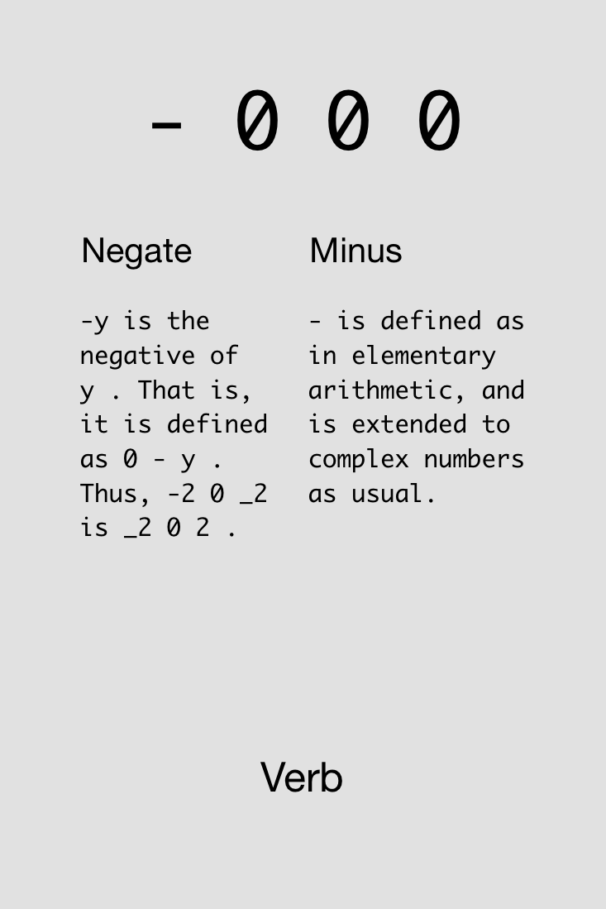

Slide 22

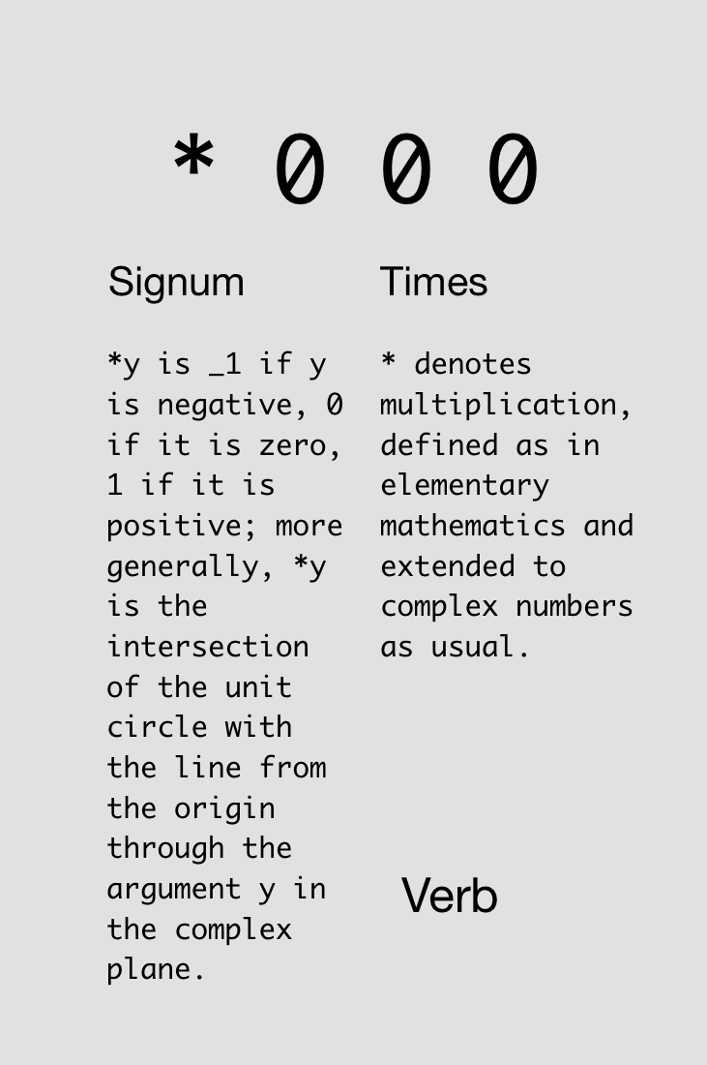

Slide 23

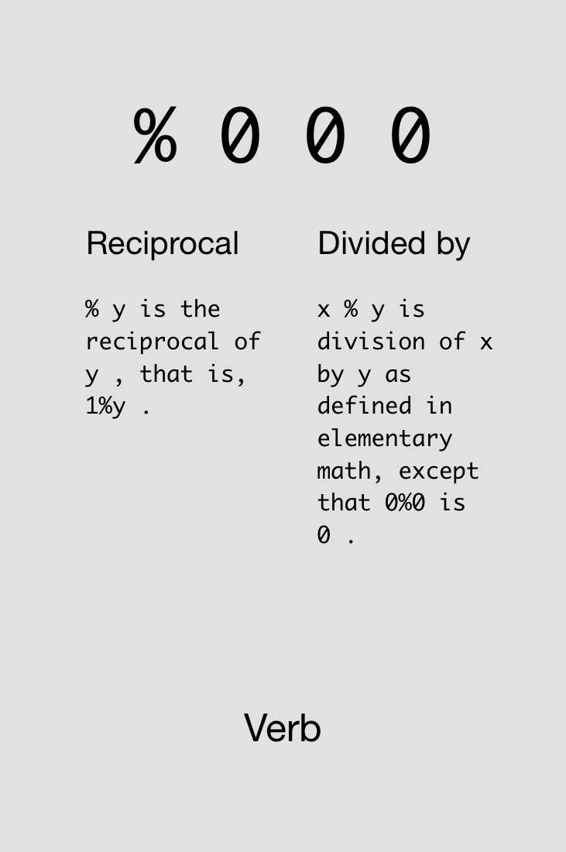

Slide 24
Monads & Dyads

Slide 25
y is right arg
x is left arg,
y is right arg

Slide 26
Monad vs. Dyad %:
2%7
0.285714
7%2
3.5
%7
0.142857
%2
0.5

Slide 27

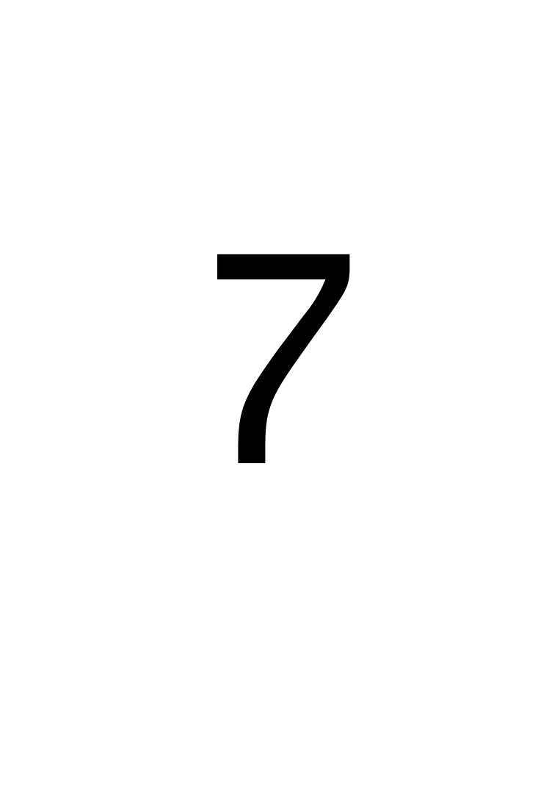



Challenge!
Compute the arithmetic mean of 4 and 7.
Find three solutions using all of these cards simultaneously:
3x
3x
4x
3x
5x
2x
2x

Slide 28
Solutions!
Compute the arithmetic mean of 4 and 7.

Slide 29

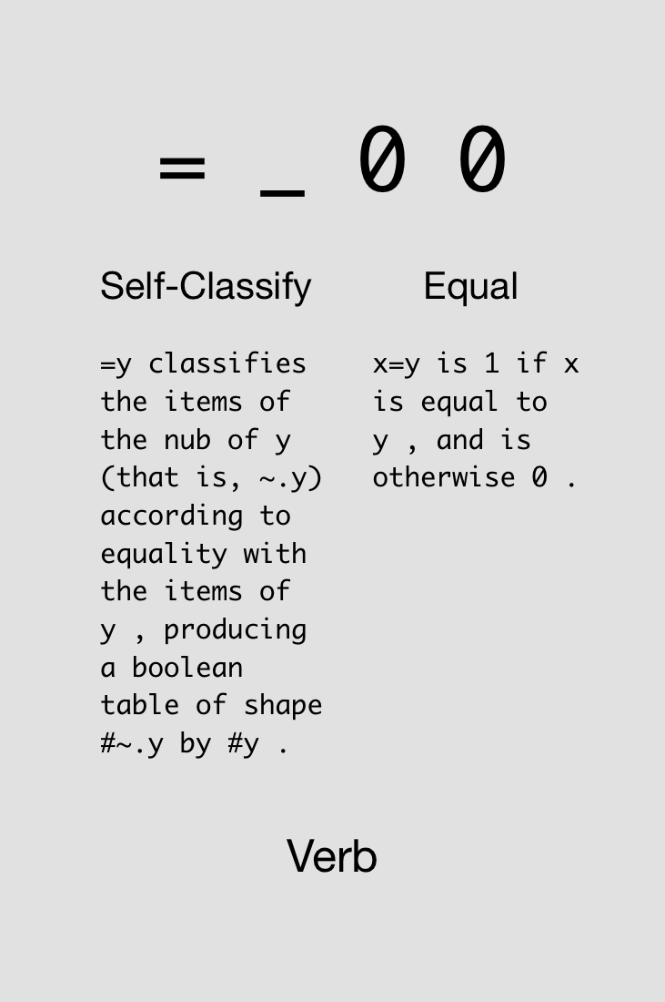

Slide 30

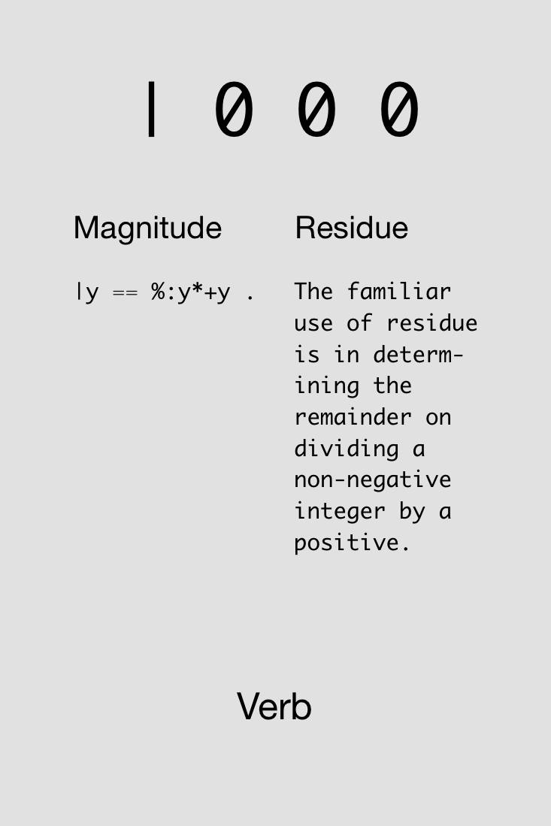

Slide 31

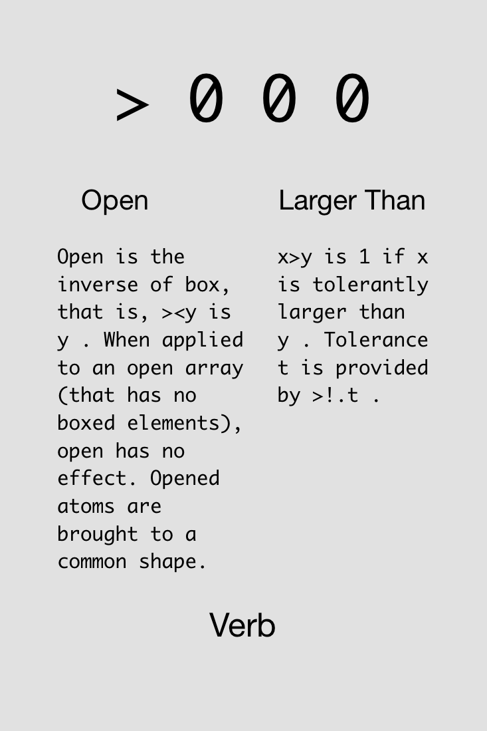

Slide 32

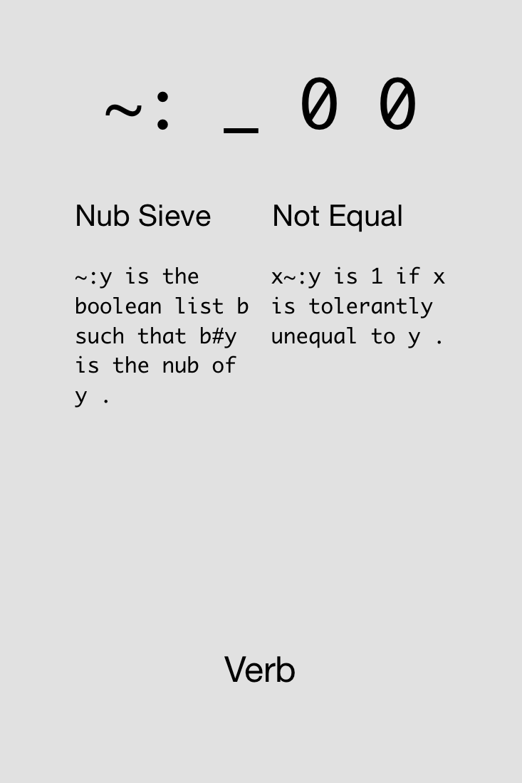

Slide 33

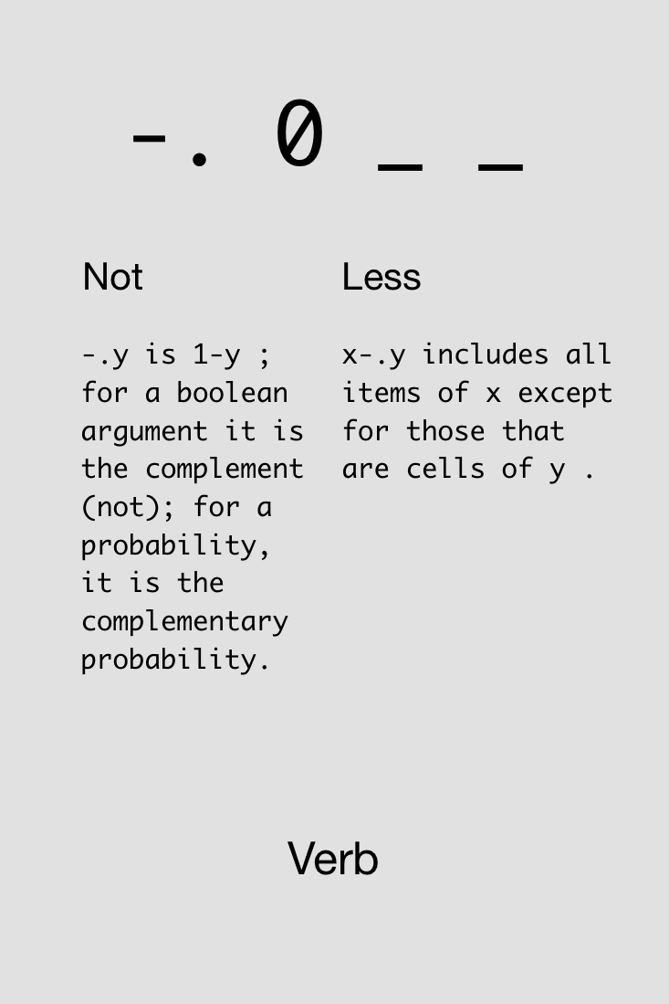

Slide 34



Challenge!
Compute whether a number, say 8, is even (gives 1 if even, 0 otherwise).
Find four solutions using all of these cards simultaneously:
1x
2x
4x
1x
4x
4x
1x
1x
1x

Slide 35
Solutions!
Compute whether a number, say 8, is even (gives 1 if even, 0 otherwise).

Slide 37
Try not to reinvent the rut

Slide 38
Arrays

Slide 39
Any variable can be an array. As for what the type and dimensioning is: you assigned the variable, didn't you? It contains whatever you put into it, a number, a string, an array, a structure... J will remember. If your program logic requires you to find out the current attributes of a variable, J can tell you.
J for C Programmers

Slide 40
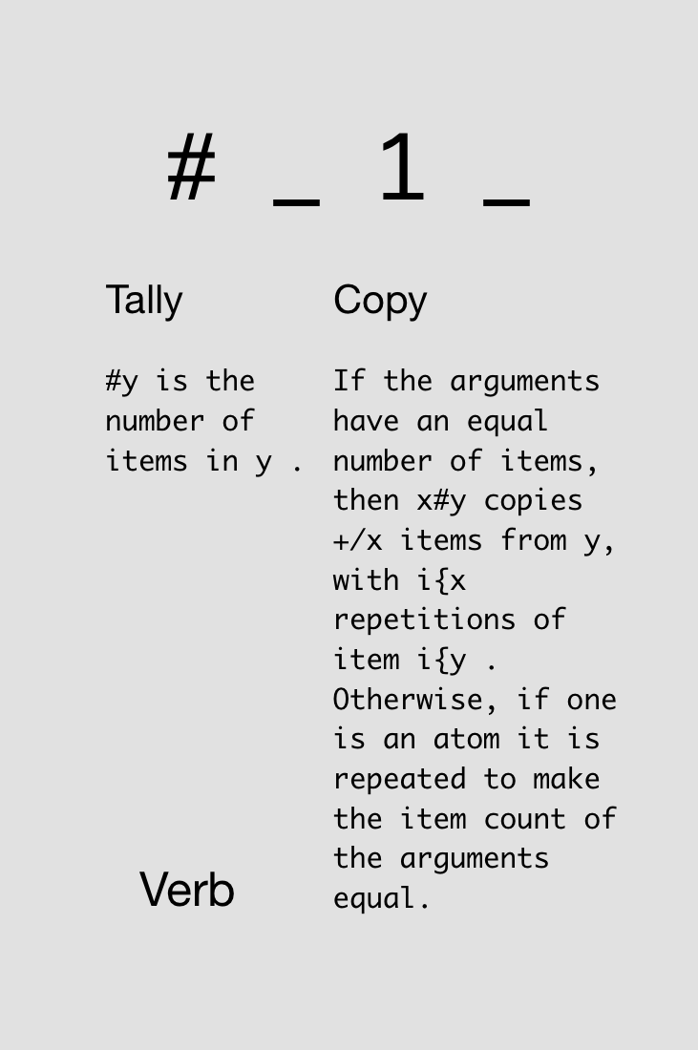

Notes:
Just monadic form

Slide 41
Variable assignment and array size:
a =: 5 3 7 9
a
5 3 7 9
#a
4
s =: 'hello'
#s
5

Slide 42
In J, every operator has a loop built in.
J for C Programmers

Slide 43
Automatic element-by-element operations:
1 2 3 + 4 5 6
5 7 9
1 + 4 5 6
5 6 7
1 2 + 4 5 6
|length error
| 1 2 +4 5 6

Slide 44
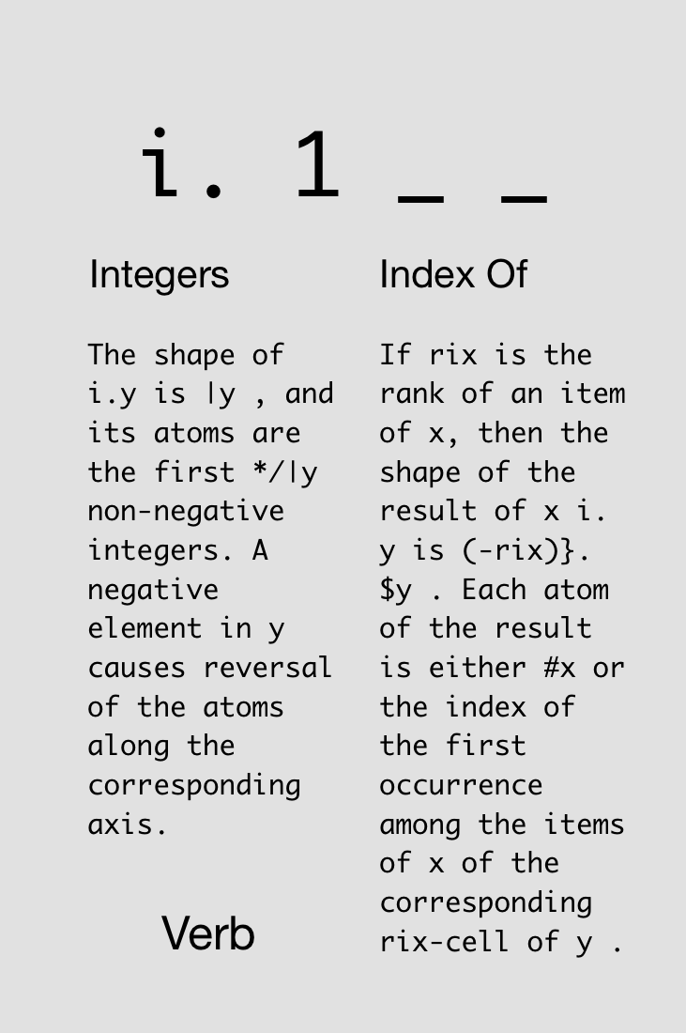


Slide 45
Notes:
Now dyadic form

Slide 46
i.4
0 1 2 3
3+i.4
3 4 5 6
3#i.4
0 0 0 1 1 1 2 2 2 3 3 3
#3#i.4
12
3##i.4
4 4 4

Slide 47
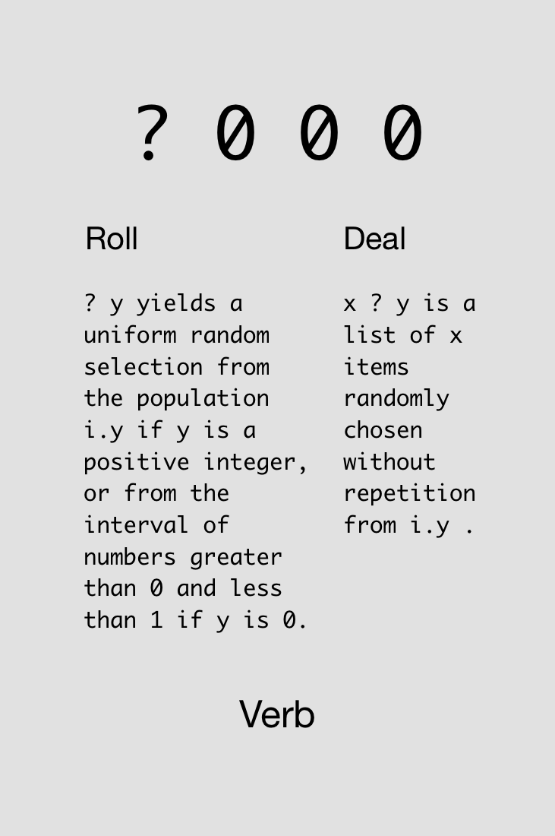



Slide 48
?5
1
?5
4
?0
0.654682
?5 2 3 6
3 1 0 4
3?7
1 4 2

Slide 49



Challenge!
Roll five d20 dice with +3 modifiers on all rolls.
Find four solutions using all of these cards simultaneously:
4x
4x
4x
4x
4x
4x
4x
2x
Notes:
>: intentionally not described ahead of time

Slide 50
Solutions!
Roll five d20 dice with +3 modifiers on all rolls.

Slide 51
Solutions!
Roll five d20 dice with +3 modifiers on all rolls.

Slide 52
Adverbs
Notes:
Loopless coding

Slide 53
A noun holds data; a verb operates on one or two nouns to produce a result which is a noun; an adverb operates on one noun or verb to produce a derived entity.
J for C Programmers

Slide 54
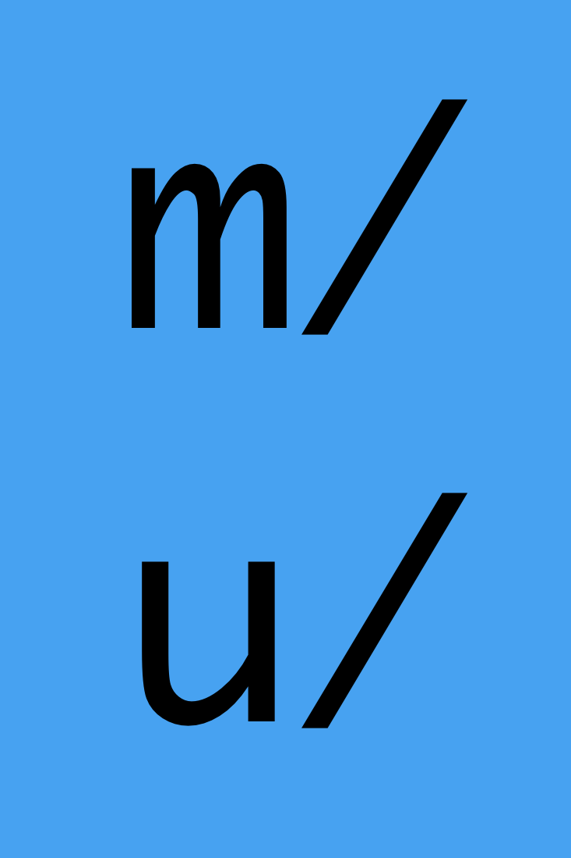
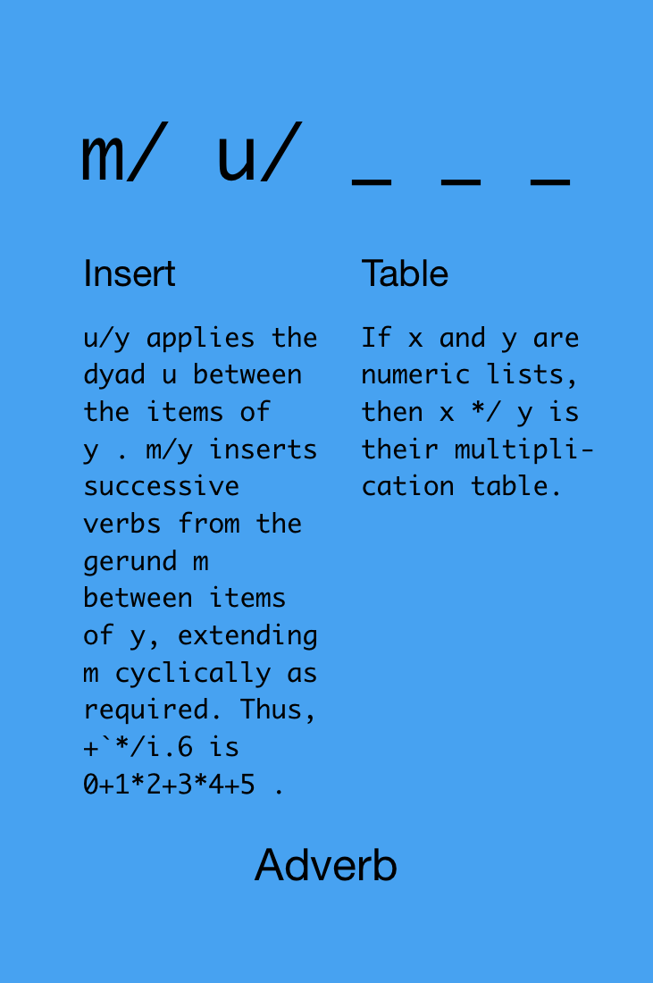

Slide 55
1+2+3+4+5
15
+/1 2 3 4 5
15
*/1 2 3 4 5
120

Slide 56
New version of “arithmetic mean”:
vals=:3 _4 7 9 _2 3
+/vals
16
#vals
6
(+/vals)%(#vals)
2.66667
+/vals%#vals
2.66667

Slide 57

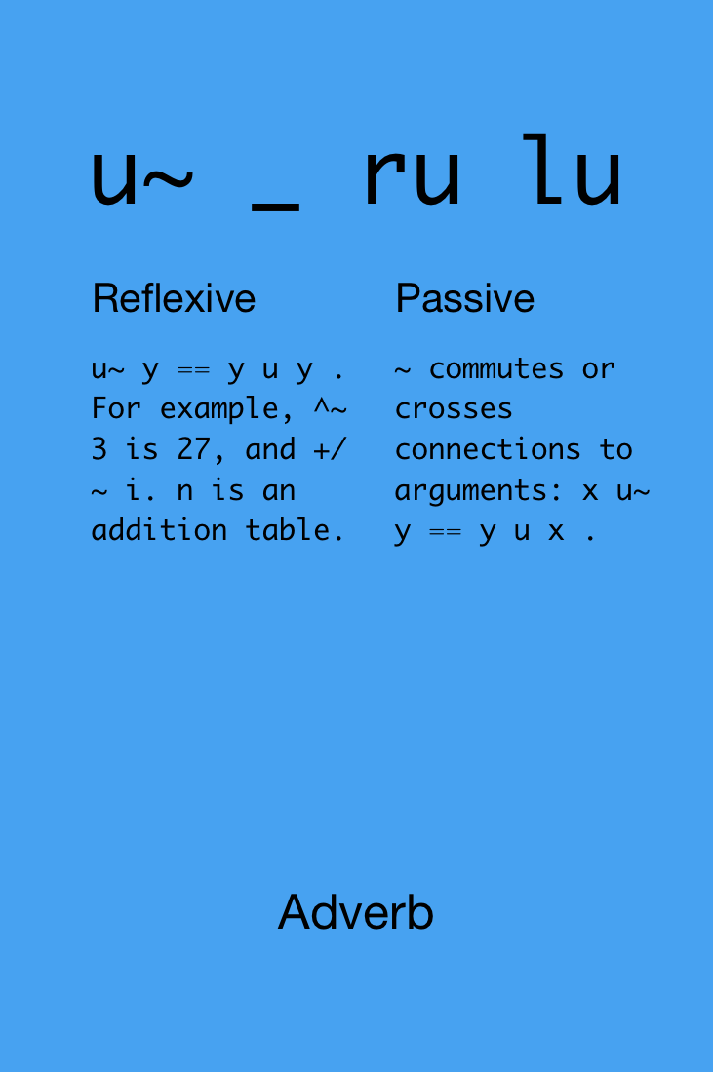
Notes:
ru = rank of right side of u
lu = rank of left side of u
(flipped!)

Slide 58

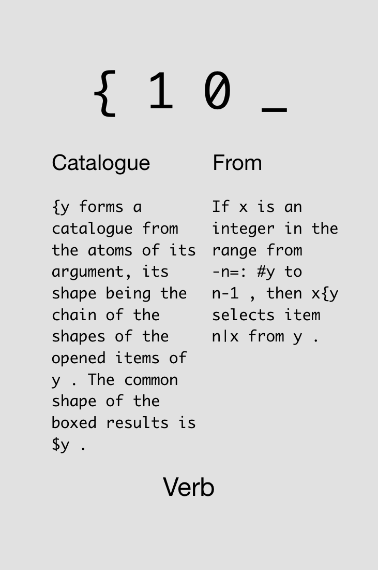
Notes:
“-n=: #y to n-1” means: from (first let n=4) -4 to 3

Slide 59



Challenge!
Given a string (or any array) s, determine if it’s a palindrome.
Find two solutions using all of these cards simultaneously:
5x
s
1x
1x
1x
2x
1x
1x
1x
1x
1x
2x
Notes:
|. intentionally not described ahead of time

Slide 60
Solutions!
Given a string (or any array) s, determine if it’s a palindrome.
s
s
s
s

Slide 62
Devalue having

Slide 63
Hooks & Forks

Slide 64
Hooks
fg
Monadic
fg y == y f (g y)
-% y == y - (% y)
Dyadic
x fg y == x f (g y)
x -% y == x - (% y)

Slide 65
f =: monad : '0=2|y' NB. checks that y is even
i.10
0 1 2 3 4 5 6 7 8 9
f i.10
1 0 1 0 1 0 1 0 1 0
NB. use # operator to keep only evens
(f i.10) # i.10
0 2 4 6 8
NB. use a hook
(#~f) i.10 NB. i.e., i.10 #~ (f i.10)
0 2 4 6 8 NB. i.e., (f i.10) # i.10

Slide 66
Forks
fgh
Monadic
fgh y == (f y) g (h y)
-+% y == (- y) + (% y)
Dyadic
x fgh y == (x f y) g (x h y)
x -+% y == (x – y) + (x % y)

Slide 67

Challenge!
Define the arithmetic mean and geometric mean for any list of numbers. Geometric mean = (x₁*x₂*…*x_{n})^(1/n).
Find one solution for each kind of mean using all of these cards simultaneously:
1x
2x
1x
1x
2x
1x

Slide 68
Solutions!
Define the arithmetic mean and geometric mean for any list of numbers.
arithmetic mean
geometric mean

Slide 69
Conjunctions

Slide 70
J uses the names x, y, u, v, m, and n to represent arguments to verbs and other entities. You should avoid using these names for other purposes.
J for C Programmers
Notes:
x, y: verb args (left, right)
u, v: verbs
m, n: nouns

Slide 71

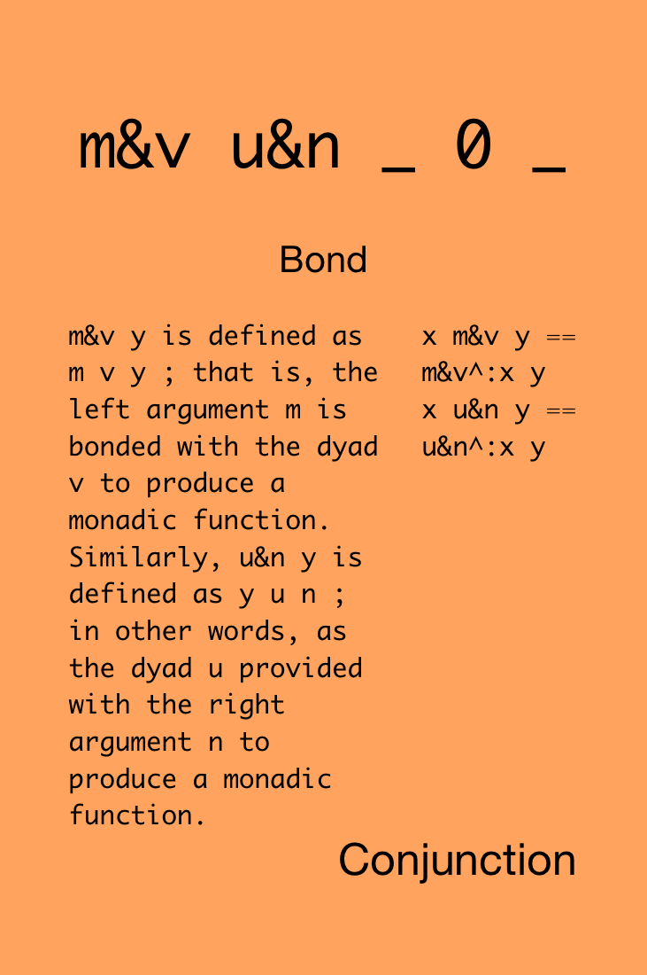

Slide 72
f =: 5&+
f 1 2 3 4 5
6 7 8 9 10
g =: -&5
g 1 2 3 4 5
_4 _3 _2 _1 0
2 f 1 2 3 4 5 NB. recursively applies 5&+ twice
11 12 13 14 15
3 g 1 2 3 4 5 NB. recursively applies -&5 three times
_14 _13 _12 _11 _10

Slide 73

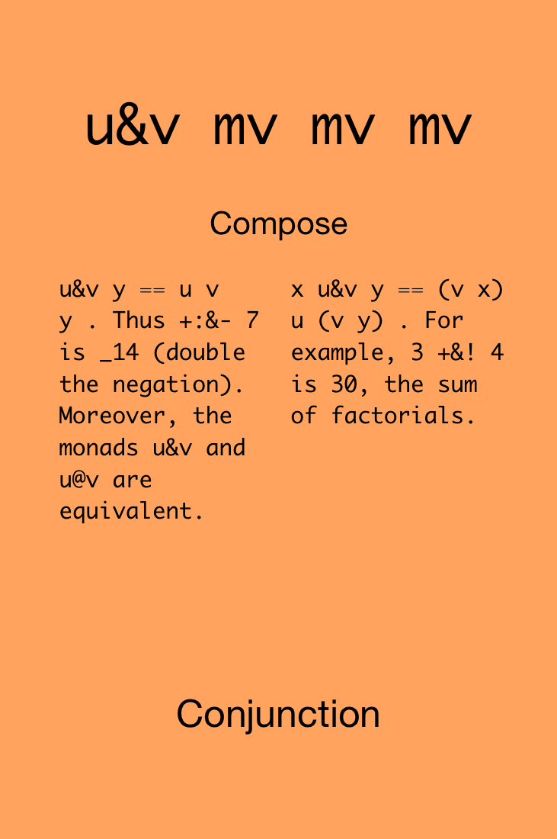

Slide 74
f =: -&% NB. i.e., -(%y)
f 1 2 3 4 5
_1 _0.5 _0.333333 _0.25 _0.2
10 f 1 2 3 4 5 NB. i.e., (%x)-(%y)
_0.9 _0.4 _0.233333 _0.15 _0.1
g =: -% NB. compare with hook
g 1 2 3 4 5 NB. i.e., y-(%y)
0 1.5 2.66667 3.75 4.8
10 g 1 2 3 4 5 NB. i.e., x-(%y)
9 9.5 9.66667 9.75 9.8

Slide 75

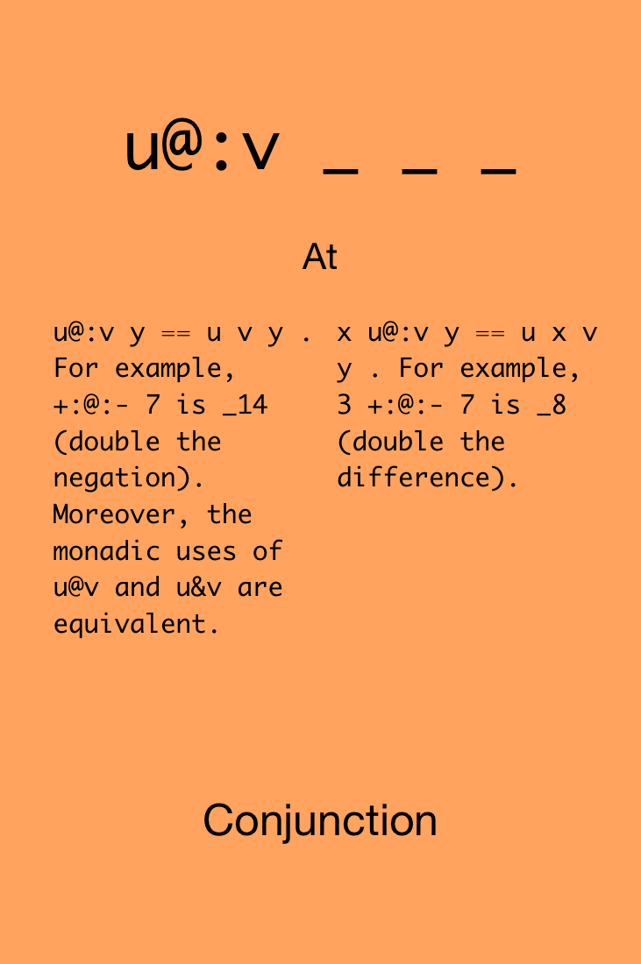

Slide 76
f =: -@:% NB. same as & in monadic form
f 1 2 3 4 5
_1 _0.5 _0.333333 _0.25 _0.2
10 f 1 2 3 4 5 NB. i.e., - (x % y)
_10 _5 _3.33333 _2.5 _2
f =: +/@:% NB. i.e., +/ (% y)
f 1 2 3 4 5 NB. i.e., sum reciprocals of y
2.28333

Slide 77


Challenge!
Define the L¹, L², and L∞ norms.
L¹ = sum(absval(x_{i})) for all x_{i}
L² = sqrt(sum(x_{i}²) for all x_{i})
L ∞ = max(x_{i}) for all x_{i}
Find one solution for each norm using all of these cards simultaneously:
2x
3x
3x
1x
1x
1x
1x

Slide 78
Solutions!
Define the L¹, L², and L∞ norms.
L¹ = sum(absval(x_{i})) for all x_{i}
L² = sqrt(sum(x_{i}²) for all x_{i})
L ∞ = max(x_{i}) for all x_{i}
L¹
L ∞
L²

Slide 80
Never put a seat belt around your intuition

Slide 81
Atoms, Lists,
Tables, et al.

Slide 82
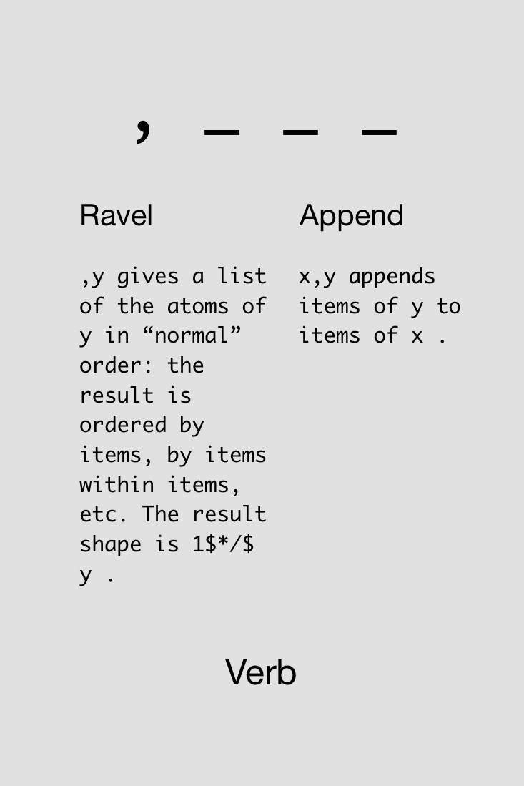

Slide 83
(i.3) (i.5)
|syntax error
| (i.3)(i.5)
(i.3),(i.5)
0 1 2 0 1 2 3 4

Slide 84

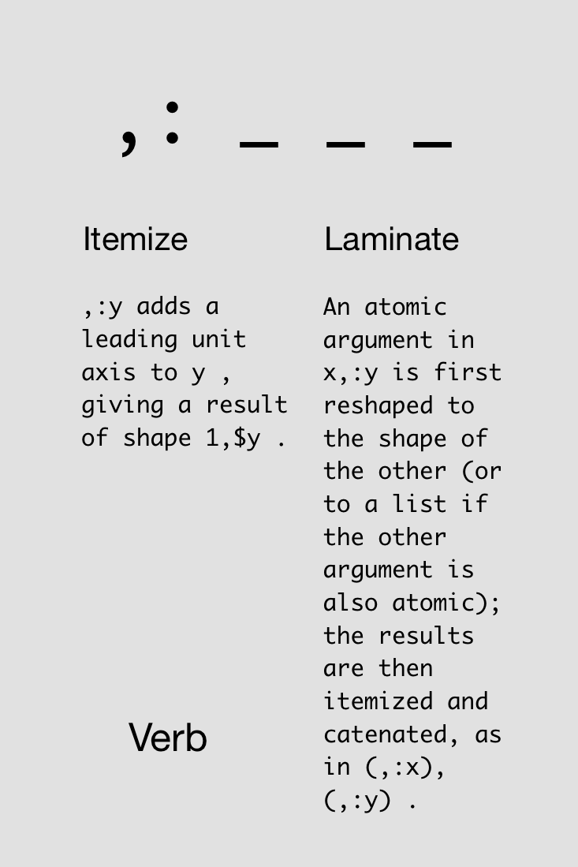

Slide 85
pt1 =: 5.1 3.5 1.4 0.2
pt2 =: 4.9 3.0 1.4 0.2
pt3 =: 4.7 3.2 1.3 0.2
pt1 , pt2 , pt3
5.1 3.5 1.4 0.2 4.9 3 1.4 0.2 4.7 3.2 1.3 0.2
pt1 , pt2 ,: pt3
5.1 3.5 1.4 0.2
4.9 3 1.4 0.2
4.7 3.2 1.3 0.2

Slide 86

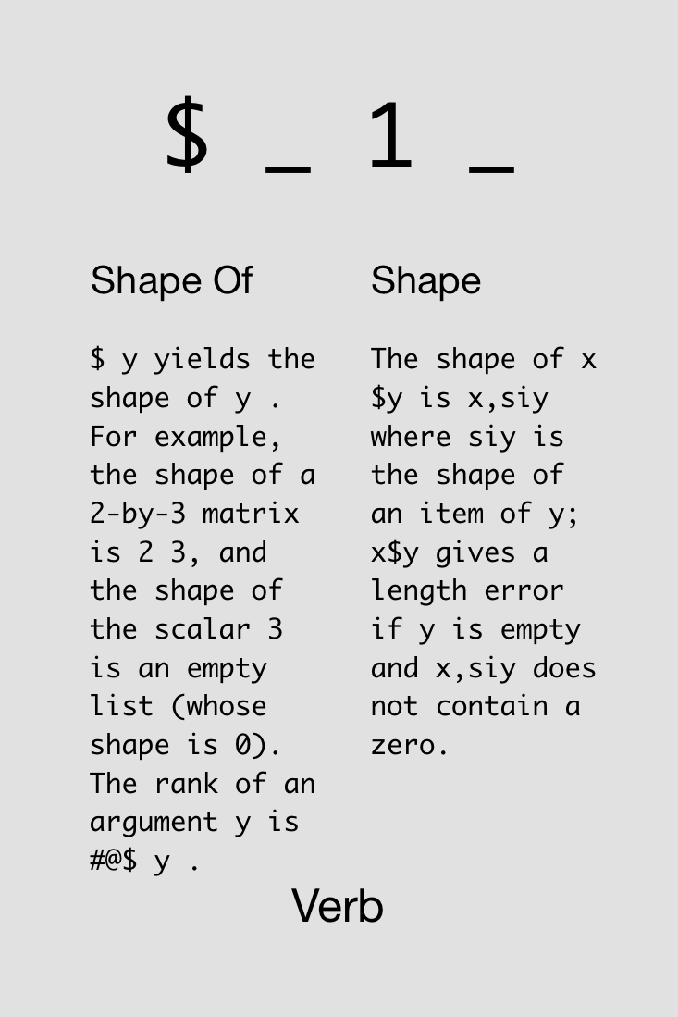

Slide 87
pt1 , pt2 , pt3
5.1 3.5 1.4 0.2 4.9 3 1.4 0.2 4.7 3.2 1.3 0.2
$ pt1 , pt2 , pt3
12
pt1 , pt2 ,: pt3
5.1 3.5 1.4 0.2
4.9 3 1.4 0.2
4.7 3.2 1.3 0.2
$ pt1 , pt2 ,: pt3
3 4

Slide 88
Rank

Slide 89
The rank of a noun is the count of its axes. An atom has rank 0, a list rank 1, a table rank 2, and an array with 5 axes has rank 5.
J Primer

Slide 90
$ pt1 , pt2 , pt3
12
# $ pt1 , pt2 , pt3 NB. #$ computes rank
1
$ pt1 , pt2 ,: pt3
3 4
# $ pt1 , pt2 ,: pt3
2
NB. etc.

Slide 91
Ask the rank of a verb.
+ b.0
0 0 0
- b.0
0 0 0
i. b.0
1 _ _
$ b.0
_ 1 _
,: b.0
_ _ _

Slide 92
If you don’t know the rank of a verb, you don’t know the verb. Using a verb of unknown rank is like wiring in a power-supply of unknown voltage–it will do something when you plug it in; it might even work; but if the voltage is wrong it will destroy what it’s connected to. Avoid embarrassment! Know the rank of the verbs you use.
J Primer

Slide 93

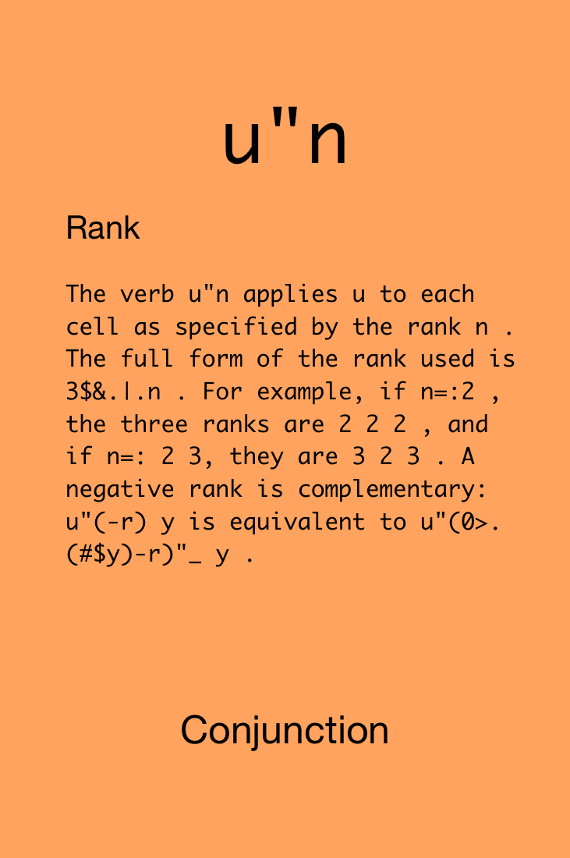

Slide 94
100 200 300 + (1 2 3 4)
|length error
| 100 200 300 +(1 2 3 4)
100 200 300 +"0 _ (1 2 3 4)
101 102 103 104
201 202 203 204
301 302 303 304
100 200 300 +"_ 0 (1 2 3 4)
101 201 301
102 202 302
103 203 303
104 204 304

Slide 95
Show how a verb would be applied.
load 'general/misc/fndisplay'
defverbs 'divide'
setfnform 'J'
8 divide 10
┌───────────┐
│8 divide 10│
└───────────┘
4 8 divide 10 20
┌──────────────────┐
│(4 8) divide 10 20│
└──────────────────┘

Slide 96
4 8 (divide"0) 10 20
┌───────────┬───────────┐
│4 divide 10│8 divide 20│
└───────────┴───────────┘
4 8 (divide"1) 10 20
┌──────────────────┐
│(4 8) divide 10 20│
└──────────────────┘

Slide 97
i.2 3
0 1 2
3 4 5
4 (divide"0) i.2 3
┌──────────┬──────────┬──────────┐
│4 divide 0│4 divide 1│4 divide 2│
├──────────┼──────────┼──────────┤
│4 divide 3│4 divide 4│4 divide 5│
└──────────┴──────────┴──────────┘

Slide 98
4 (divide"1) i.2 3
┌──────────────┬──────────────┐
│4 divide 0 1 2│4 divide 3 4 5│
└──────────────┴──────────────┘
4 (divide"_) i.2 3
┌─────────────────────────────┐
│4 divide 2 3$(0 1 2) (3 4 5) │
└─────────────────────────────┘

Slide 99
(i.2 3) (divide"0 0) i.2 3
┌──────────┬──────────┬──────────┐
│0 divide 0│1 divide 1│2 divide 2│
├──────────┼──────────┼──────────┤
│3 divide 3│4 divide 4│5 divide 5│
└──────────┴──────────┴──────────┘

Slide 100
(i.2 3) (divide"1 0) i.2 3
┌────────────────┬────────────────┬────────────────┐
│(0 1 2) divide 0│(0 1 2) divide 1│(0 1 2) divide 2│
├────────────────┼────────────────┼────────────────┤
│(3 4 5) divide 3│(3 4 5) divide 4│(3 4 5) divide 5│
└────────────────┴────────────────┴────────────────┘

Slide 101
(i.2 3) (divide"1 1) i.2 3
┌────────────────────┬────────────────────┐
│(0 1 2) divide 0 1 2│(3 4 5) divide 3 4 5│
└────────────────────┴────────────────────┘

Slide 102
(i.2 3) (divide"1 _) i.2 3
┌───────────────────────────────────┬───────────────────────────────────┐
│(0 1 2) divide 2 3$(0 1 2) (3 4 5) │(3 4 5) divide 2 3$(0 1 2) (3 4 5) │
└───────────────────────────────────┴───────────────────────────────────┘
(i.2 3) (divide"_ 0) i.2 3
┌───────────────────────────────┬───────────────────────────────┬───────────────────────────────┐
│(2 3$(0 1 2) (3 4 5) ) divide 0│(2 3$(0 1 2) (3 4 5) ) divide 1│(2 3$(0 1 2) (3 4 5) ) divide 2│
├───────────────────────────────┼───────────────────────────────┼───────────────────────────────┤
│(2 3$(0 1 2) (3 4 5) ) divide 3│(2 3$(0 1 2) (3 4 5) ) divide 4│(2 3$(0 1 2) (3 4 5) ) divide 5│
└───────────────────────────────┴───────────────────────────────┴───────────────────────────────┘
(i.2 3) (divide"0 _) i.2 3
┌─────────────────────────────┬─────────────────────────────┬─────────────────────────────┐
│0 divide 2 3$(0 1 2) (3 4 5) │1 divide 2 3$(0 1 2) (3 4 5) │2 divide 2 3$(0 1 2) (3 4 5) │
├─────────────────────────────┼─────────────────────────────┼─────────────────────────────┤
│3 divide 2 3$(0 1 2) (3 4 5) │4 divide 2 3$(0 1 2) (3 4 5) │5 divide 2 3$(0 1 2) (3 4 5) │
└─────────────────────────────┴─────────────────────────────┴─────────────────────────────┘
(i.2 3) (divide"_ _) i.2 3
┌──────────────────────────────────────────────────┐
│(2 3$(0 1 2) (3 4 5) ) divide 2 3$(0 1 2) (3 4 5) │
└──────────────────────────────────────────────────┘

Slide 103
In J, every operator has a loop built in.
J for C Programmers

Slide 104
Coding Challenge!
Write code that fills in the blanks and produces the given output.
Compute the column sums of a table.
Compute the arithmetic mean of every row in a pair of tables.
Recall the arithmetic mean is +/%#
______ i.4 6
36 40 44 48 52 56
______ i.2 3 6
2.5 8.5 14.5
20.5 26.5 32.5

Slide 105
Solutions!
Write code that fills in the blanks and produces the given output.
Compute the column sums of a table.
Compute the arithmetic mean of every row in a pair of tables.
Recall the arithmetic mean is +/%#
+/ i.4 6
36 40 44 48 52 56
(+/%#)"1 i.2 3 6
2.5 8.5 14.5
20.5 26.5 32.5
Notes:
Challenge: what if second case was “1 ? Answer: would compute average of columns of each table

Slide 107
If you’re lucky enough to experience a miracle,
try not to micro manage it

Slide 108
Recursion

Slide 109
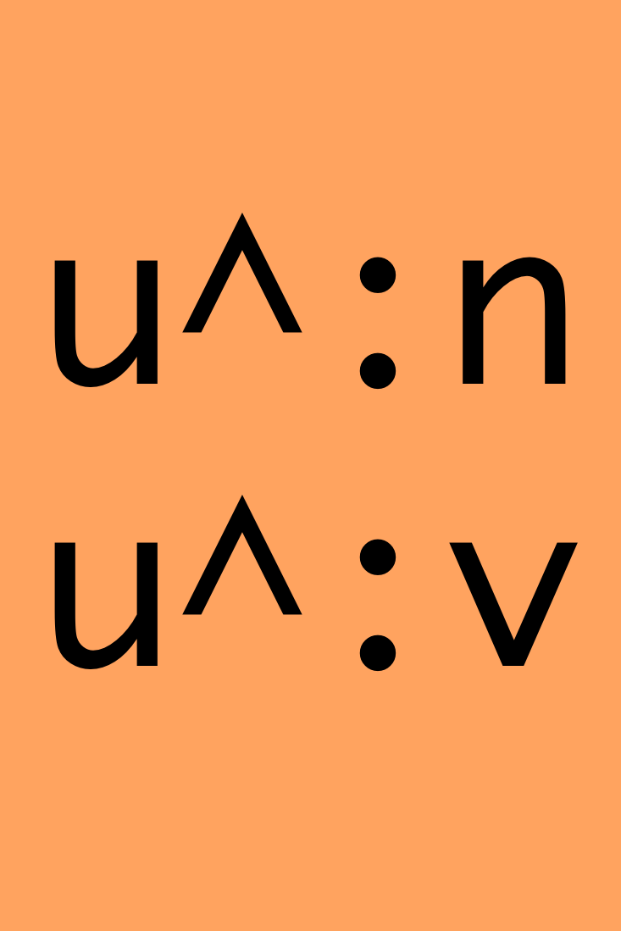
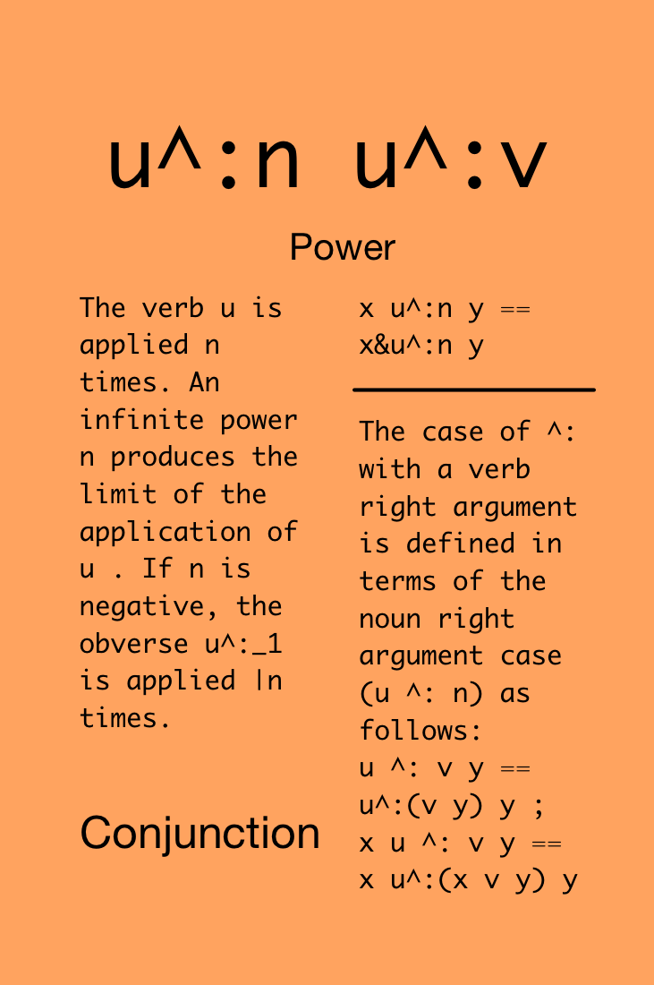

Slide 110
Recursive “Larger of” >.
vals=:4 3 2 $ 24?100
>./vals
96 95
70 85
60 89
>./>./vals
96 95
>./>./>./vals
96
>./^:3 vals NB. recursive application, 3 times
96
>./^:_ vals NB. 'limit' of >./, works on any shape
96
Notes:
^:_ applies until the value stops changing

Slide 111
NB. interesting cases of u^:n
NB. do-once
(>:^:1) 10 NB. increment once
11
NB. do-many
(>:^:5) 10 NB. increment five times
15
NB. don’t
(>:^:0) 10 NB. returns y
10

Slide 112
NB. interesting cases of u^:n
NB. do various times
(>:^:(i.10)) 10 NB. increment 0, 1, …, 9 times
10 11 12 13 14 15 16 17 18 19
NB. obverse (aka inverse)
(>:^:_1) 10 NB. decrement once
9
NB. do-infinitely-many-times
(cos^:_) 1 NB. compute y=cos(y)
0.739085

Slide 114
NB. highly interesting cases of u^:v
NB. do sometimes
1 2 3 4 5 ((>:@[)^:])"0 (1 0 0 1 0)
2 2 3 5 5
NB. explanation:
NB. ] keeps right side, [ keeps left side
NB. >:@[ means "increment vals of left argument"
NB. ^:] means apply power (^:) n times, where n
NB. comes from right side
NB. finally, "0 means apply ^: to each value

Slide 115
NB. written another way…
myfunc =: >: NB. define function to apply
if =: adverb define
'' NB. no monadic form
:
y u@]^:["0 x NB. here is the dyadic form
)
1 2 3 4 5 myfunc if 1 0 0 1 0
2 2 3 5 5

Slide 116
NB. more fancy
even =: monad : '0=2|y' NB. checks that y is even
myfunc =: >:
NB. use a hook!
(myfunc if even) 1 2 3 4 5
1 3 3 5 5
NB. the above turned into:
NB. 1 2 3 4 5 (myfunc if) (even 1 2 3 4 5)
NB. 1 2 3 4 5 (myfunc if) 0 1 0 1 0

Slide 117
NB. do while…
NB. (u^:v)^:_ ends when the output of v is the same
NB. as the prior time; supposing v is boolean (0/1),
NB. then ^:_ stops when v produces 0, yielding u^:0
dowhile =: conjunction define
(u^:(v@:])^:_"0) y
:
x (u^:(v@:])^:_"0) y
) NB. continue doubling a number until it’s >= 100
2 * dowhile (100&>) 1 3 5 7 9 11
128 192 160 112 144 176

Slide 118
NB. defining “if” and “dowhile” as a J adverb (if)
NB. and conjunction (dowhile) gives us the benefits
NB. of automatic looping:
(2&* if even) i. 2 3 2
0 1
4 3
8 5
12 7
16 9
20 11

Slide 119
NB. defining “if” and “dowhile” as a J adverb (if)
NB. and conjunction (dowhile) gives us the benefits
NB. of automatic looping:
(2&* dowhile (100&>)) i. 2 3 2
0 128
128 192
128 160
192 112
128 144
160 176

Slide 120
Coding Challenge!
Write code that fills in the blanks and produces the given output.
Given a number N and a list of scores, compute the average of the scores after dropping the lowest N scores. Create one solution using ^: and one solution without using ^: Feel free to use define.
1 ______ 90 70 80 75 NB. drop 1 score
81.6667
2 ______ 90 70 80 75 NB. drop 2 scores
85
3 ______ 95 60 0 55 80 0 90 NB. drop 3 scores
78.333

Slide 121
Solutions!
avgDropLowest =: dyad define
((+/%#)@:((}.@:/:~)^:x)) y NB. with ^:
)
avgDropLowest2 =: dyad define
((+/%#)@:((x&}.)@:/:~)) y NB. without ^:
)
1 avgDropLowest 90 70 80 75
81.6667
2 avgDropLowest 90 70 80 75
85
3 avgDropLowest2 95 60 0 55 80 0
78.333

Slide 123
Avoid both picking at minutia and sideswiping mountains

Slide 124
Big Data

Slide 125
You may at first worry that you're using too much memory, or that you might misuse the processor's caches; get over it. Apply verbs to large operands.
J for C Programmers

Slide 126
Jd, the J relational database.
load 'jd'
NB. create a database folder
jdadminx'bbjd'
NB. set path to CSV files to load
CSVFOLDER=:F=:'/home/jeckroth/chautauquas/zigzag/'
NB. create a "cdefs" file that describes the dataset
jd'csvcdefs /h 1 backblaze-2013-2016.csv'

Slide 127
NB. load the backblaze data (60mil rows)
jd'csvrd backblaze-2013-2016.csv backblaze'
NB. the data are stored as one binary file per column;
NB. when you come back, just type jdadmin'mydbname'
NB. show the db schema
jd'info schema'
┌─────────┬──────────────┬───────┬─────┐
│table │column │type │shape│
├─────────┼──────────────┼───────┼─────┤
│backblaze│date │edate │ _ │
│backblaze│serial_number │byte │15 │
│backblaze│model │byte │23 │
│backblaze│capacity_bytes│int │ _ │
│backblaze│failure │boolean│ _ │
│backblaze│smart_187_raw │int │ _ │
└─────────┴──────────────┴───────┴─────┘

Slide 128
NB. read some data
jd'reads date,capacity_bytes from backblaze'
...
│2013-04-10│ 3000592982016│
│2013-04-10│ 3000592982016│
│2013-04-10│ 3000592982016│
│2013-04-10│ 2000398934016│
│2013-04-10│ 2000398934016│
...
│2016-12-29│ 322056190273242112│
│2016-12-30│ 322052189486212096│
│2016-12-31│ 322056190273242112│
└──────────┴────────────────────┘
NB. save result
capacity_by_day =: (...above...)

Slide 129
NB. results are "boxed" (each box can hold a different type)
NB. so let's unbox just the capacities
capacities =. ,/ > 1 1 { capacity_by_day
capacities
54041214222213120 54041214222213120 54041214222213120 53861178805862400 55657532182339584 55657532182339584 55792558378819584 55796559165849600 55796559165849600 55796559165849600 55796559165849600 55795058863939584 55795058863939584 55930085548130304 ...
$ capacities
1360
NB. find min, max capacity
<./ capacities
_8946789308003949568
>./ capacities
1282429594186119424

Slide 130
NB. avg capacity
(+/%#) capacities
3.55142e12
NB. or ask jd to compute avg using one of several agg verbs
jd'info agg'
┌───────────┐
│aggs │
├───────────┤
│avg │
│count │
│countunique│
│first │
│last │
│max │
│min │
│sum │
└───────────┘
jd'reads avg capacity_bytes from backblaze
┌──────────────┐
│capacity_bytes│
├──────────────┤
│3.55142e12 │
└──────────────┘ NB. 5sec

Slide 131
NB. compute overall failure rate
failures =: ,/>0{1{ jd'reads failure from backblaze'
$ failures
59654783
+/failures NB. total failures
5806
overallAFR =: 365*100*(+/failures)%(#failures)
overallAFR
3.55242

Slide 132
NB. compute failures by year
dates =: >0{1{ jd'reads date from backblaze'
$ dates
59654783 10 NB. ugh, dates are strings now
2 {. dates
2013-04-10
2013-04-10
(4&{."1) 2 {. dates NB. keep only first four digits
2013
2013
NB. 0". converts strings to numbers
years =: 0 ". (4&{."1) dates
$ years
59654783

Slide 133

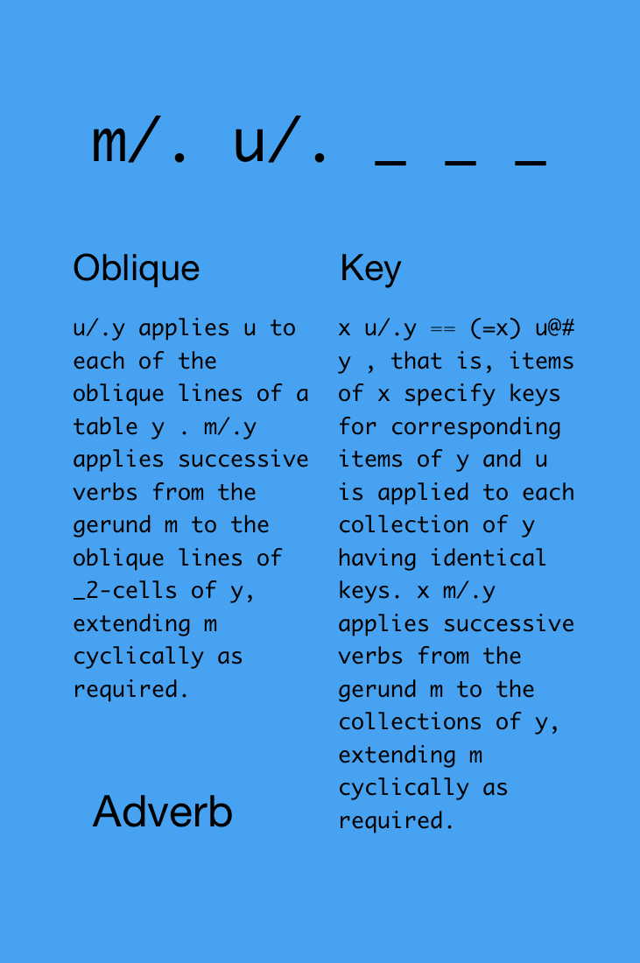
NB. ok, we have years
NB. how do we sum failures per year?
NB. note /. adverb, known as "key"

Slide 134
NB. ok, we have years
NB. how do we sum failures per year?
NB. note /. adverb, known as "key"
NB. example usage:
2013 2013 2014 2015 2015 +//. 2 3 7 11 12
5 7 23
NB. hence:
driveFailuresYears =: years +//. failures NB. 1sec driveFailuresYears
740 2206 1429 1431

Slide 135
NB. likewise:
driveDays =: years #/. failures
driveDays
5091501 12582414 17509251 24471617
NB. get unique years (in order of data) to match
NB. the driveFailuresYears result
uniqueYears =: ~.years NB. 1sec
uniqueYears
2013 2014 2015 2016
NB. hence hence:
yearlyAFR =: 365*100*driveFailuresYears%driveDays
uniqueYears ,: yearlyAFR
2013 2014 2015 2016
5.30492 6.39933 2.97891 2.13437

Slide 136
The big slide with timing data.
Task | Jd | R (dplyr) | MySQL
Import CSV data | 50 sec | 2 min (read_csv) | 11 min
Space on disk | 3.6 GB | 374 MB | 5.2 GB
Load data into variable | 55 sec | 1 min 45 sec | NA
Select sum(capacity) group by date | ~1 sec | ~1 sec | 4.5 min
Select avg(capacity) | ~1 sec | ~1 sec | 38 sec
Note, original CSV data was 3.2 GB.

Slide 137
Sliding your brain into neutral
engages your spiritual transmission

Slide 138
Visualization

Slide 139
load '~addons/graphics/fvj4/dwin.ijs'
_1 _1 1 1 dwin 'fun' NB. open window, -1:1 axes
1 o. 1r6p1 NB. sin(1/6 pi^1)
0.5
2 o. 1r6p1 NB. cos(1/6 pi^1)
0.866025
NB. define x,y coordinates of a circle with 200 pts
circ =: |: 2 1 o./ 1r100p1*i.200
1 0
0.999507 0.0314108
0.998027 0.0627905
0.995562 0.0941083
...

Slide 140
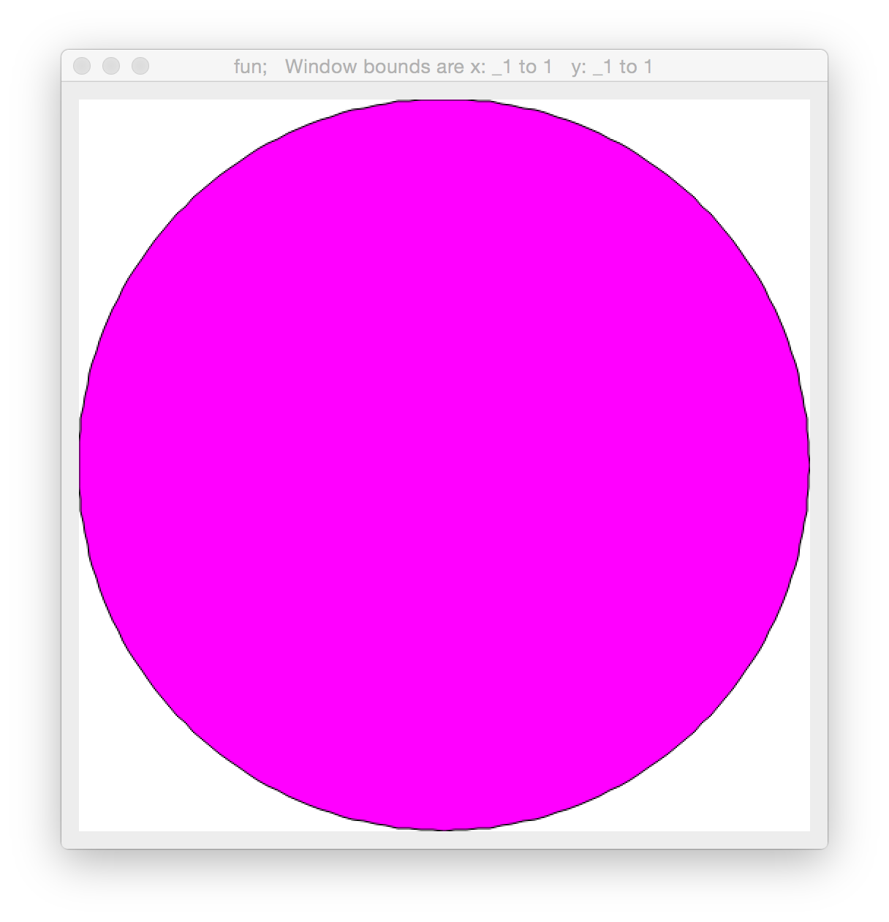
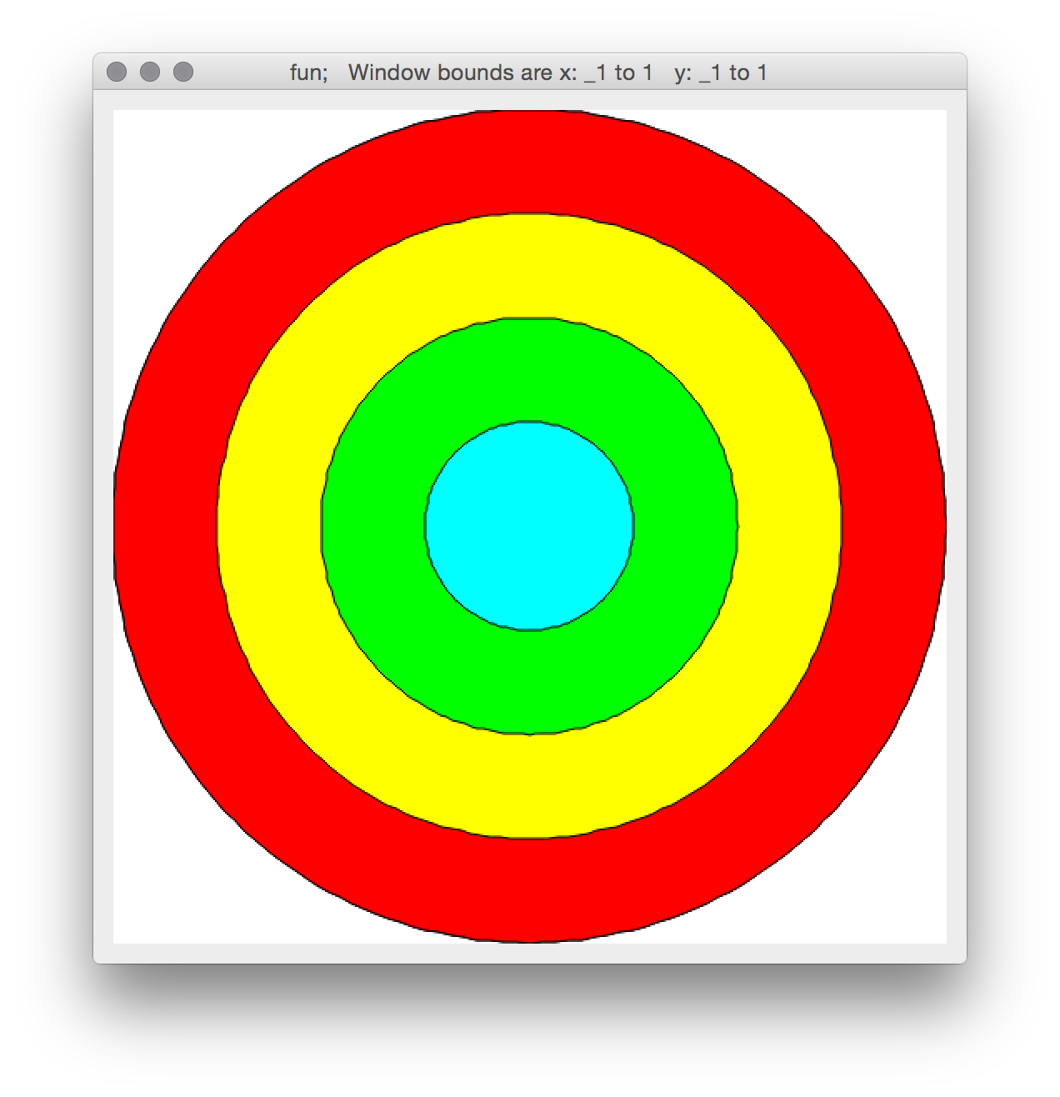
NB. plot a circle with a color
255 0 255 dpoly circ
circ4 =: 1 0.75 0.5 0.25 */ circ NB. four circles
colr4 =: 255 0 0, 255 255 0, 0 255 0,: 0 255 255
NB. plot four circles with individual colors
colr4 dpoly circ4

Slide 141
NB. generate some exponential values
(^ 0.1 * i.80) % 100
0.01 0.0110517 0.012214 0.0134986 ...
NB. generate some x,y values for a symmetric curve
xs =: ((i.180) * %180) - 0.5
ys =: ((|. (^0.075*i.90)), (^0.075*i.90))%400
curve =: |: xs ,: ys
curve
_0.5 1.98087
_0.494444 1.83774
_0.488889 1.70495
...

Slide 142
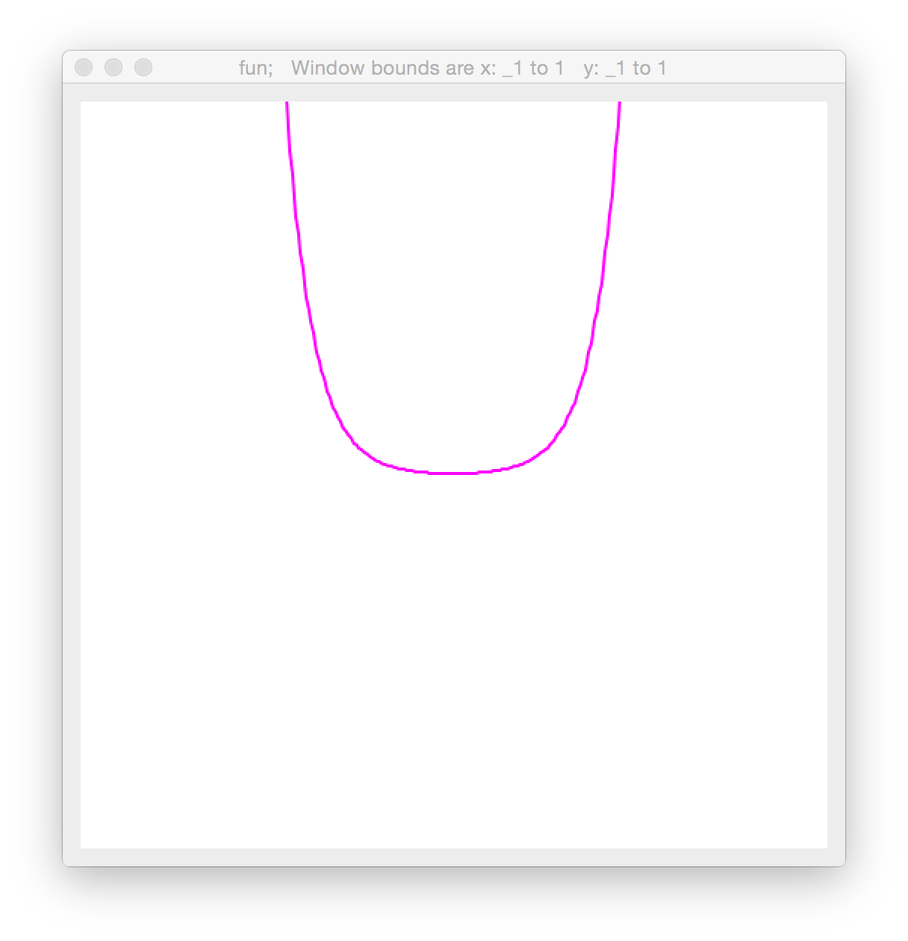
curve
_0.5 1.98087
_0.494444 1.83774
_0.488889 1.70495
...
_0.0111111 0.00269471
_0.00555556 0.0025
0 0.0025
0.00555556 0.00269471
0.0111111 0.00290459
...
0.483333 1.70495
0.488889 1.83774
0.494444 1.98087
NB. plot the curve
255 0 255 dline curve

Slide 143
Rotation can be defined as matrix multiplication of a vector representing the point: [x,y,1] and a rotation matrix:
M = [ cos(𝜃) -sin(𝜃) 0
sin(𝜃) cos(𝜃) 0
0 0 1 ]
After multiplying M*[x,y,1]^{T}, the result will be [x’,y’,z]; divide z out of x’ and y’ to get final coordinates. In our case, however, z will always be 1.
NB. define matrix mult.
mp =: +/ . *
NB. allow simple trig names
load 'trig'
NB. define rotation matrix
rotm =: (cos, sin, 0:),
(-@sin, cos, 0:),:
(0:, 0:, 1:)
rotm 1r4p1
0.707107 0.707107 0
_0.707107 0.707107 0
0 0 1
Notes:
Why is mp defined that way? It’s complicated.

Slide 144
Likewise, a translation matrix is defined as:
M = [ 1 0 xtrans
0 1 ytrans
0 0 1 ]
Translation & rotation matrices can be combined with matrix multiplication, e.g., TransM * RotM * [x,y,1]^{T}
NB. trans. matrix as verb
trans =: monad define
1 0 0, 0 1 0,: (y,1)
)
trans 5 2
1 0 0
0 1 0
5 2 1
(trans 5 2) mp (rotm 1r4p1)
0.707107 0.707107 0
_0.707107 0.707107 0
2.12132 4.94975 1
(3 2 1) mp (... above ...)
2.82843 8.48528 1

Slide 145
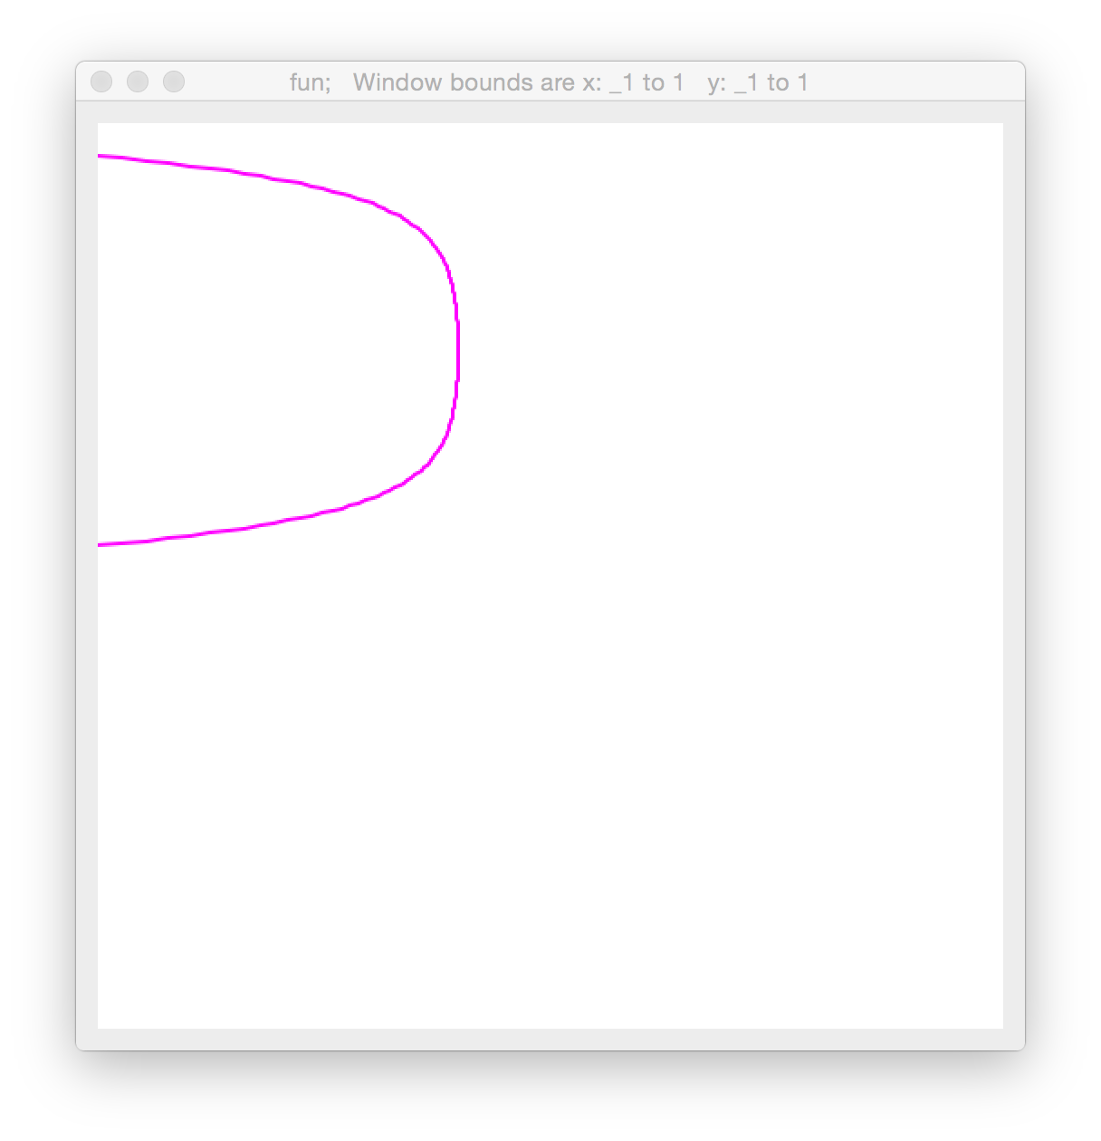
NB. add extra z=1 dimension to curve
curve =: curve,.1
NB. draw a translated, rotated curve
dclear''
255 0 255 dline curve mp (trans 0.5 0.2) mp (rotm 1r2p1)

Slide 146
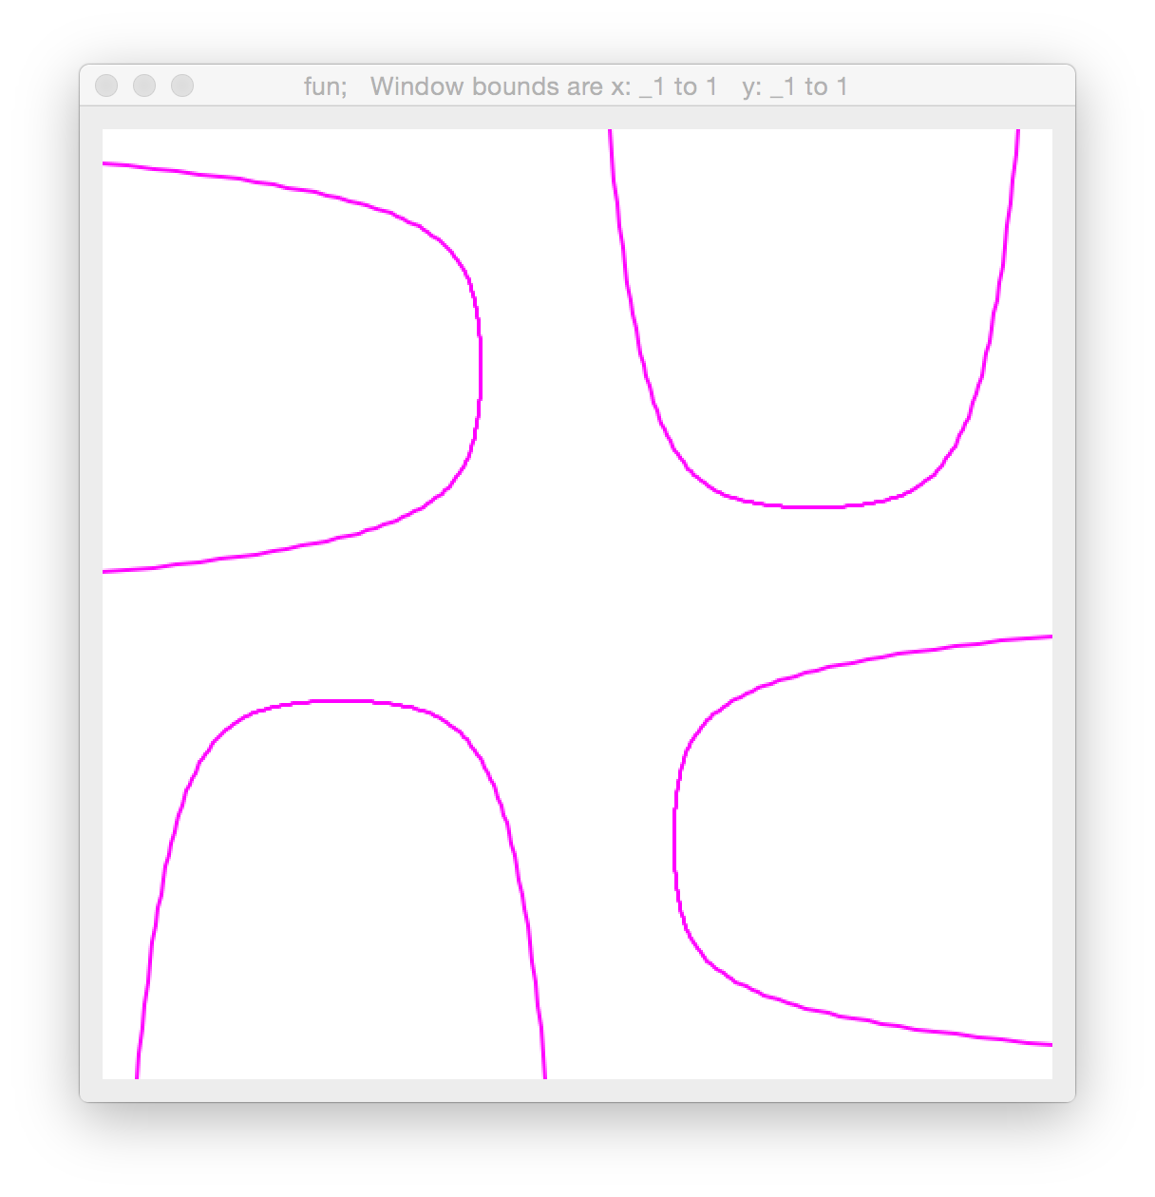
NB. define a verb for drawing curve with translate + rotate
NB. use dyad form, x=translate, y=rotate
dcurveRot =: dyad define
255 0 255 dline curve mp (trans x) mp (rotm y)
)
dclear''
0.5 0.2 dcurveRot 1r2p1
0.5 0.2 dcurveRot 2r2p1
0.5 0.2 dcurveRot 3r2p1
0.5 0.2 dcurveRot 4r2p1

Slide 147
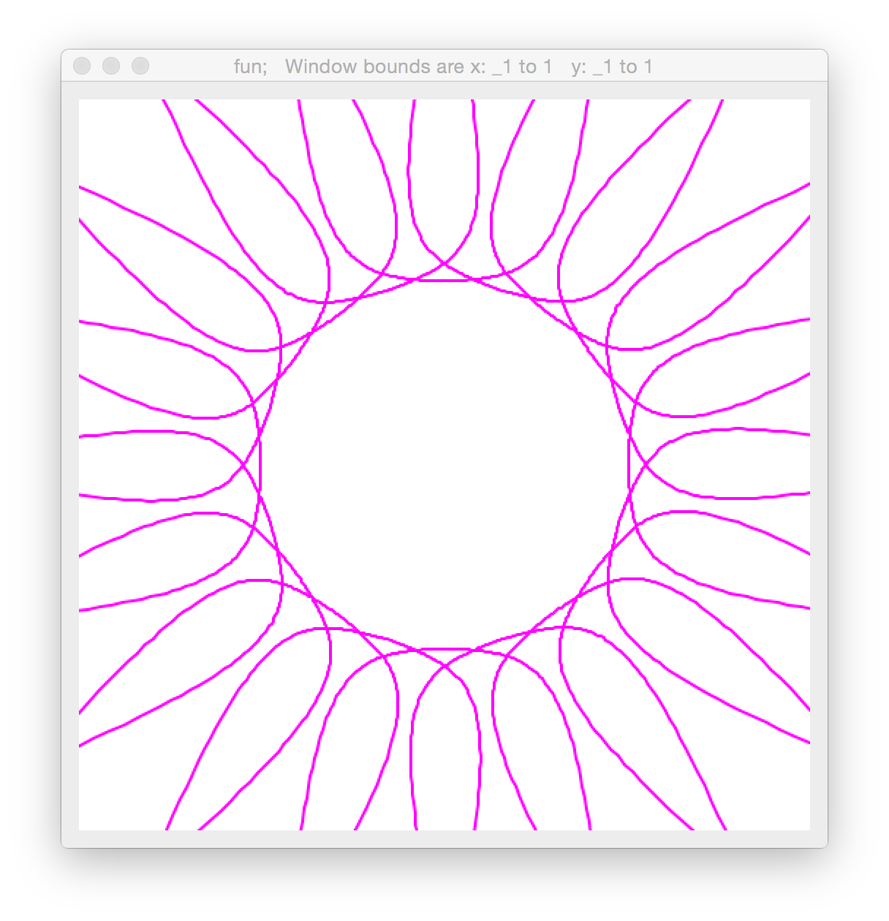
NB. draw many!
dclear''
(0 0.5 & dcurveRot)"0 (1r10p1 * i.20)
Notes:
Notice no x translation

Slide 148
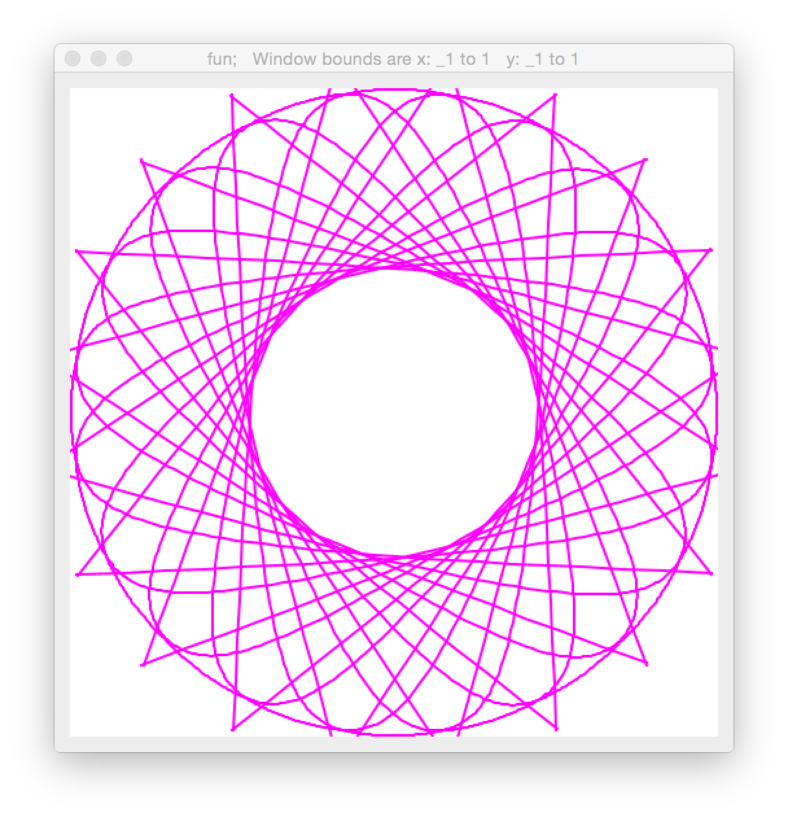
NB. unrotate by pi as the last step before drawing,
NB. and eliminate x-coordinate of translation parameter
dcurveRot =: dyad define
255 0 255 dline curve mp (rotm _1p1) mp (trans 0,x) mp (rotm y)
)
dclear''
1 dcurveRot"0 (1r10p1 * i.20)
Notes:
Notice no x translation

Slide 149
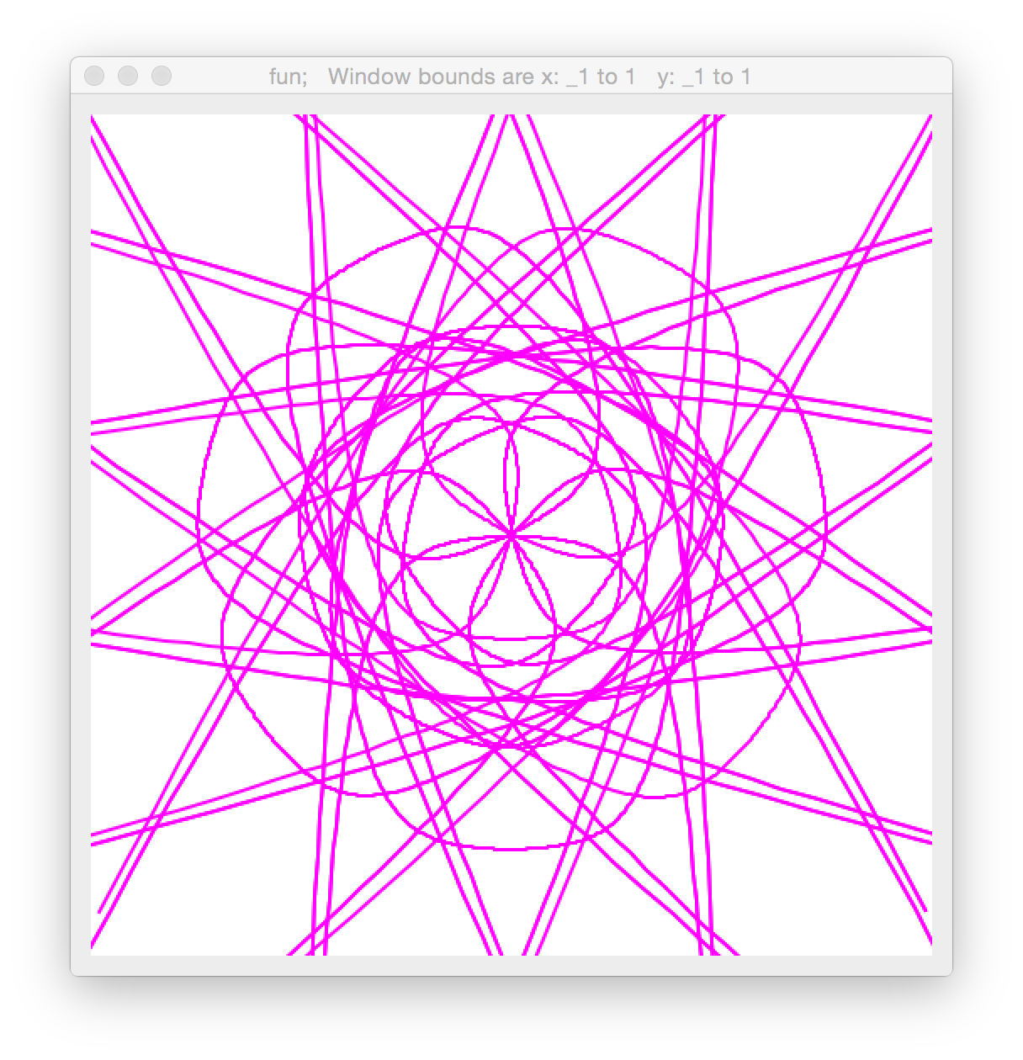
NB. generate 4 translations 0.25 apart
translations =: 0.25 * i.4
NB. generate 14 rotations 1/7 pi apart
rotations =: 1r7p1 * i.14
NB. draw each rotation/translation pairing (48 pairings)
dclear''
(48$translations) dcurveRot"0 (48$rotations)
Notes:
Notice no x translation

Slide 150
A scaling (zooming) matrix can be defined as:
M = [ s 0 0
0 s 0
0 0 1 ]
NB. scaling matrix as verb
scale =: monad define
(y, 0 0), (0, y, 0),: 0 0 1
)
scale 5
5 0 0
0 5 0
0 0 1
(scale 5) mp (trans 5 2) mp (rotm 1r4p1)
3.53553 3.53553 0
_3.53553 3.53553 0
2.12132 4.94975 1
(3 2 1) mp (... above ...)
5.65685 22.6274 1

Slide 151
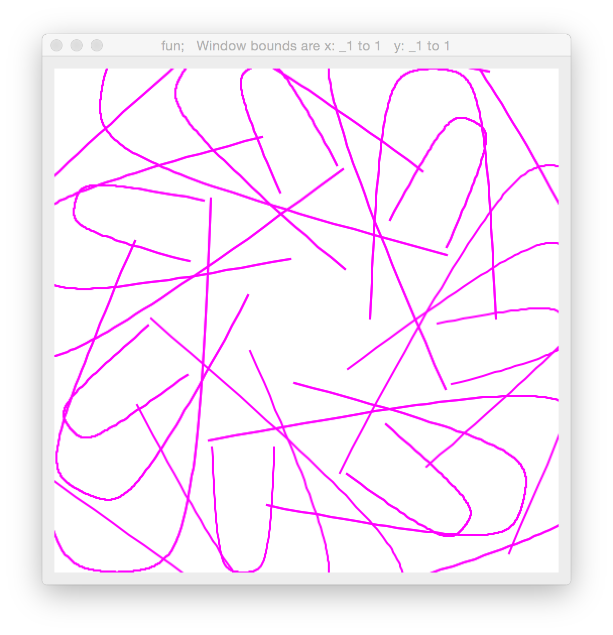
NB. update dcurveRot to use scale based on translation size
dcurveRot =: dyad define
m =. (scale x) mp (rotm _1p1) mp (trans x) mp (rotm y)
255 0 255 dline curve mp m
)
dclear''
(48$translations) dcurveRot"0 (48$rotations)

Slide 152
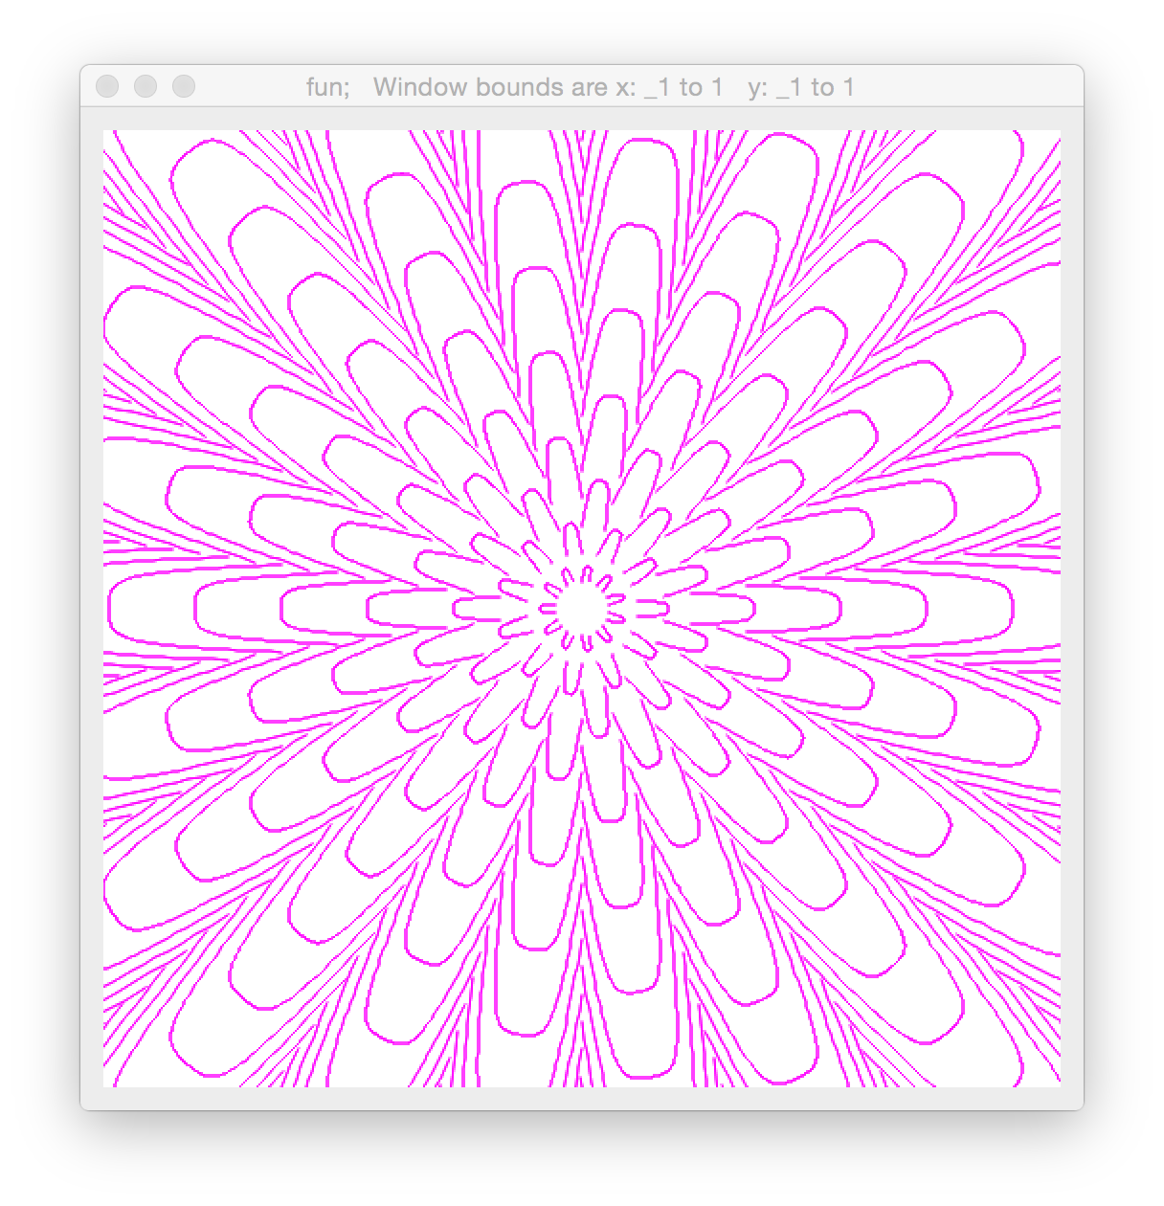
NB. update dcurveRot to use (scale 0.185*x) and
NB. obsessively fine-tune numbers to arrive at:
translations =: 0.09*i.50
rotations =: 1r22p1+1r11p1*i.22
(1100$translations) dcurveRot"0 (1100$rotations)

Slide 153

NB. next we need to set the color based on x;
NB. we’ll use HSV scale for gradual color changes
dcurveRot =: dyad define
m =. (scale 0.185*x) mp (rotm _1p1) mp (trans 0,x) mp (rotm y)
(hsv2rgb ((360|90000*x^0.015),1.0 1.0 1.0)) dline curve mp m
)

Slide 154
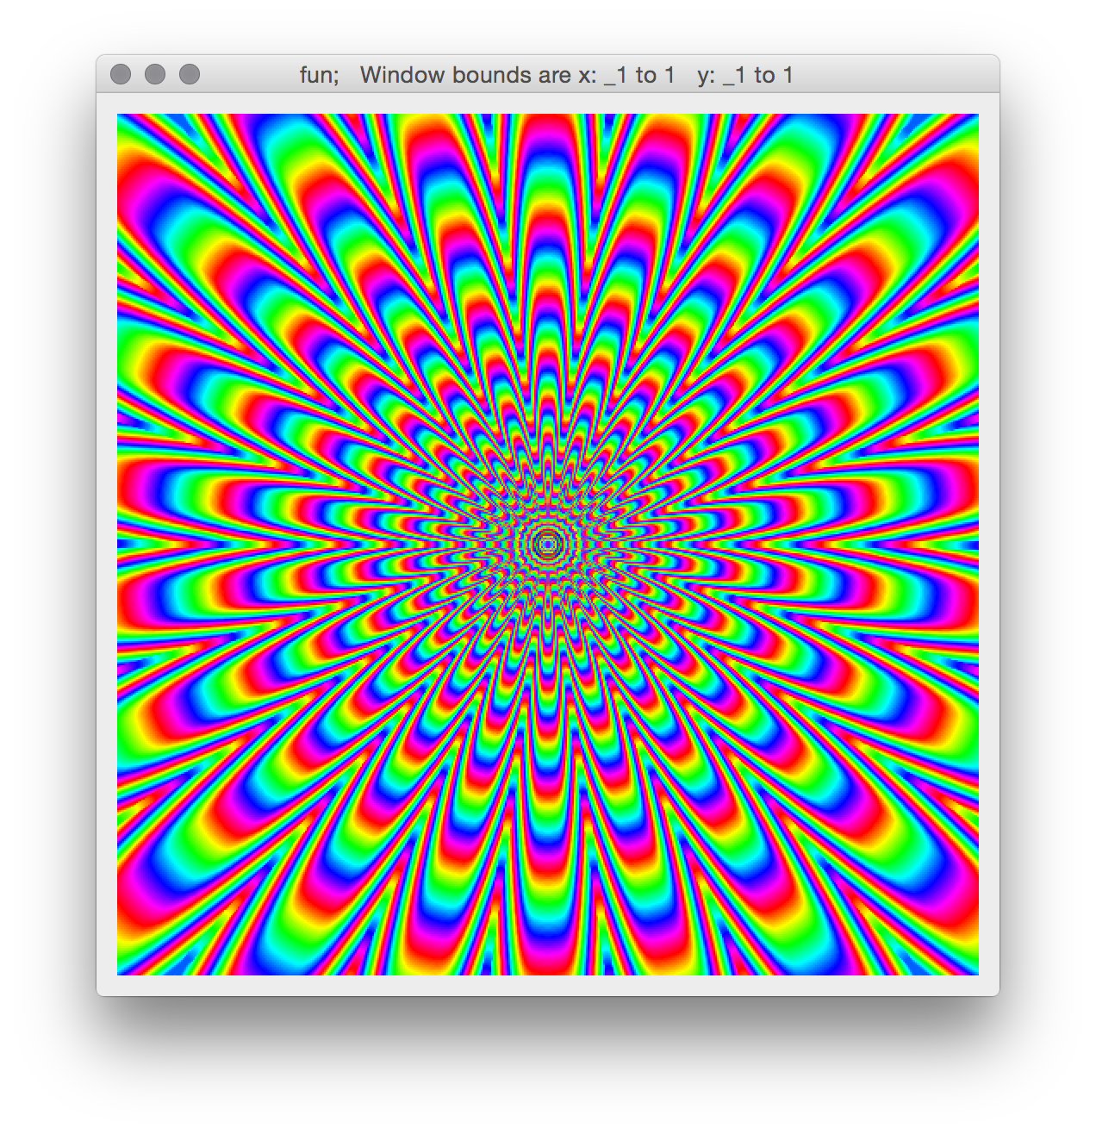
NB. MOAR CURVES
translations =: 0.005 * i.400
rotations =: 1r11p1*i.22
(22#translations) dcurveRot"0 (8800$rotations)

Slide 155
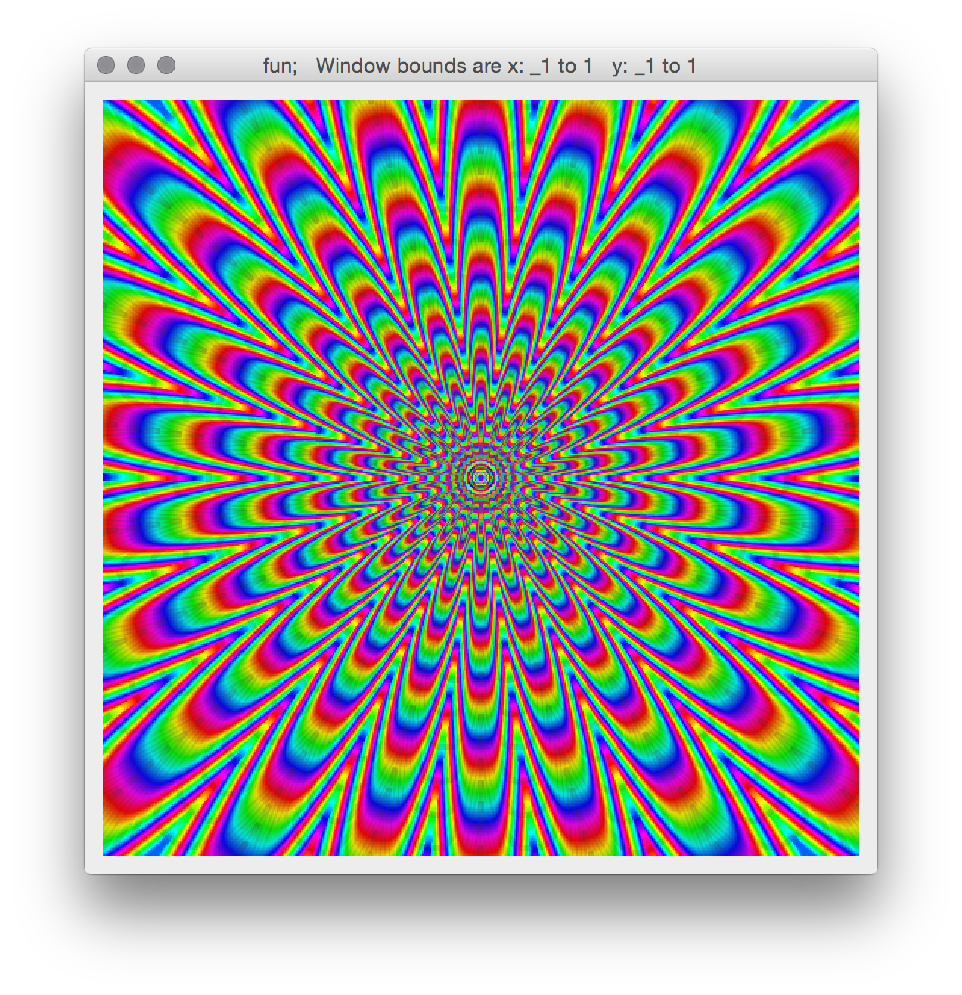
NB. add those extra curves rotated pi/22 and call it a day

Slide 157
Live for the destiny that aches for you

